Slide 1
Generic Collections: Part 2
Java How to Program, 10/e

Slide 2
Iterable(I)
Collection(2)
Set(2)
List(2)
Queue(5)
HashSet(2)
SortedSet(2)
ArrayList(2)
LinkedList(2)
Vector(1)
PQ(5)
LinkedHashSet(4)
NavigableSet(6)
Stack(1)
TreeSet(2)
Map(2)
Dictionary(1)
HashMap(2)
WeakHashMap(2)
IdentityHashMap(4)
SortedMap(2)
LinkedHashMap(4):
NavigableMap(6)
Hashtable(1)
1) Two Sorting Interfaces
a) Comparable Interface: built-in sorting algorithm
b) Comparator Interface: programmer defined sorting algorithm
2) Three Cursors : to access each element one by one
a) Enumeration Interface
b) Iterator Interface
c) ListIterator Interface
TreeMap(1.2)
Properties(1)
3) Two Utility classes
a) Collections: defines several utility methods for collection objects
b) Arrays: define several utility methods for array objects

Slide 3
Overview of Collections Framework
In Java SE 1.0, we have three interfaces and four classes
a) List Interface: Vector and stack classes implement it using array
b) Map Interface: Hashtable and Properties classes (value-pair format) it using array implementation
c) Enumeration Interface: Implanted by vector to access elements of vector
Java SE 1.2: Collection Framework is added to Java API.
Four Weakness of vector(SE 1.0) :
Slow due to synchronization problem: solution is ArrayList(SE1.2)
Insert and remove is slow: solution: LinkedList(SE 1.2)
Cannot stop duplicates: solution: Hashset(SE1.2)
Cannot store objects in sorting order: Treeset(SE1.2)
Two Weakness of Hashtable (SE 1.0) :
1. Slow due to synchronization problem: solution is HashMap(SE1.2)
2. Cannot store objects in sorting order: Treemap(SE1.2)
Weakness of Enumation Interface
(1) Method names are long and (2) cannot remove elements:
Solution: Iterator interface and ListItertaor subInterface

Slide 4
Overview of Collections Framework
Java SE 1.4:
Weakness of HashSet(SE 1.2) : Cannot maintain insertion order:
Solution is LinkedHashSet (SE1.4) as subclass of HashSet
Weakness of HashMap (SE 1.2) : Cannot maintain insertion order:
solution: LinkedHashMap(SE1.4) as subclass of HashMap
Java SE 1.5 version:
a) Enhancement in collection API:
Queue Interface
java.util.concuurent to modify SE 1. 2 and SE 1.4 into synchronized form
b) Enhancement in java language
Auto-boxing and auto-unboxing
Generics classes and generic methods
for-each loop to solve weakness of Iterator and ListIterator interface

Slide 5
Overview of Collections Framework
Java SE 1.6 version:
Enhancement in collection API:
NavigableSet
NavigableMap
Java SE 1.7 version:
Enhancement in java language:
type Inference to enhance generics concept
Java SE 1.8 version:
Enhancement in java language:
Functional Inteface
Lamda Expression
Method Reference
Enhancement in collection API:
StreamAPI also enhance “for-each Loop”

Slide 6
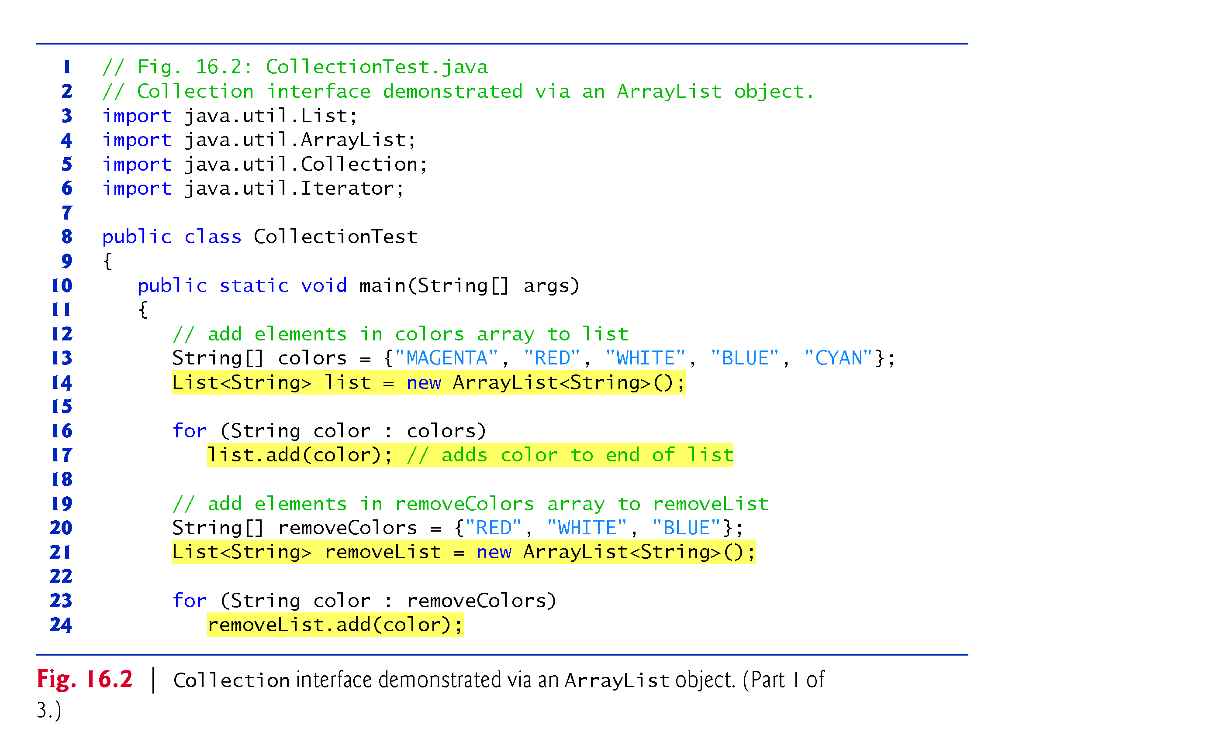
Example 1: Demo for ArrayList(C) and Iterateor(I)

Slide 7
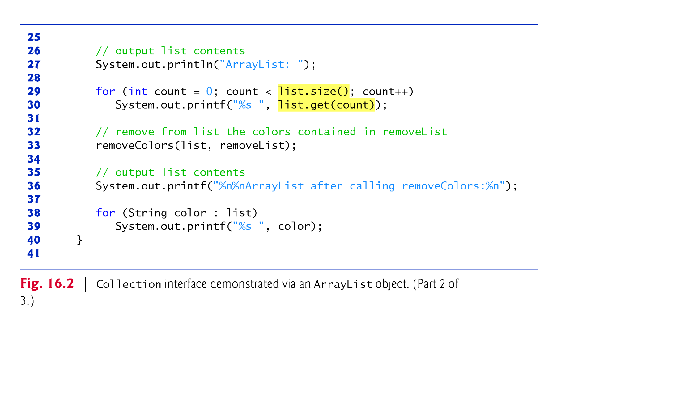
Example 1: Demo for ArrayList(C) and Iterateor(I)

Slide 8
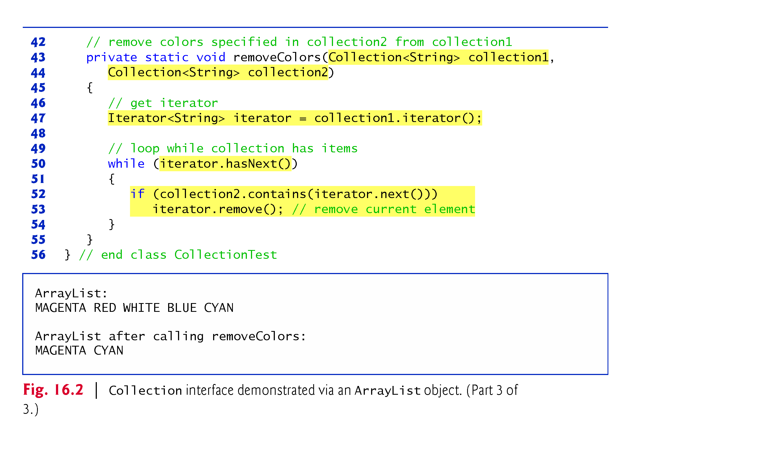
Example 1: Demo for ArrayList(C) and Iterateor(I)

Slide 9
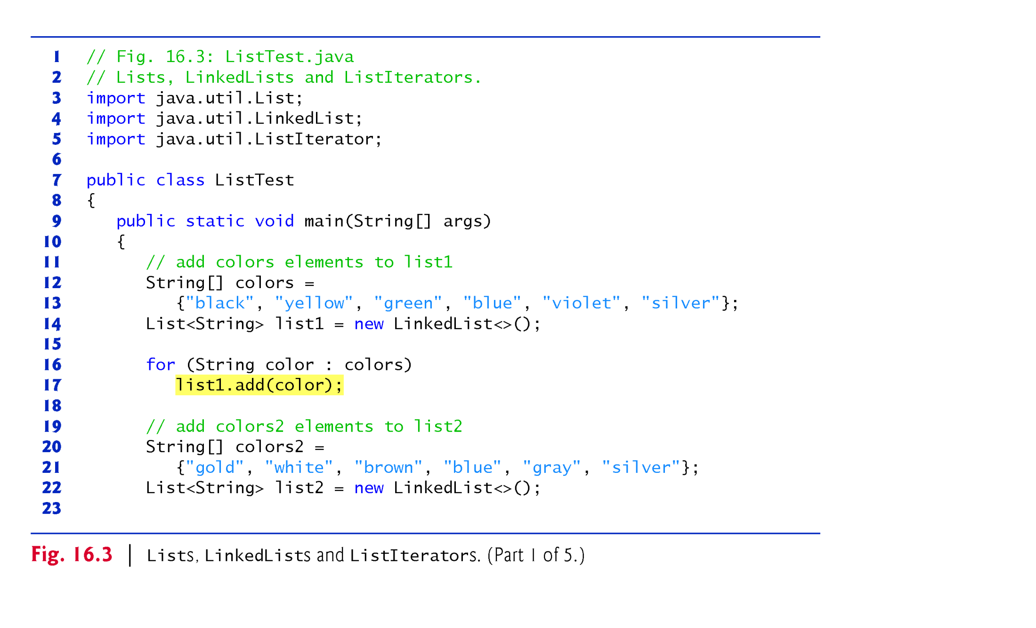
Example 2: Demo for Linked List(C) and Iterateor(I)

Slide 10
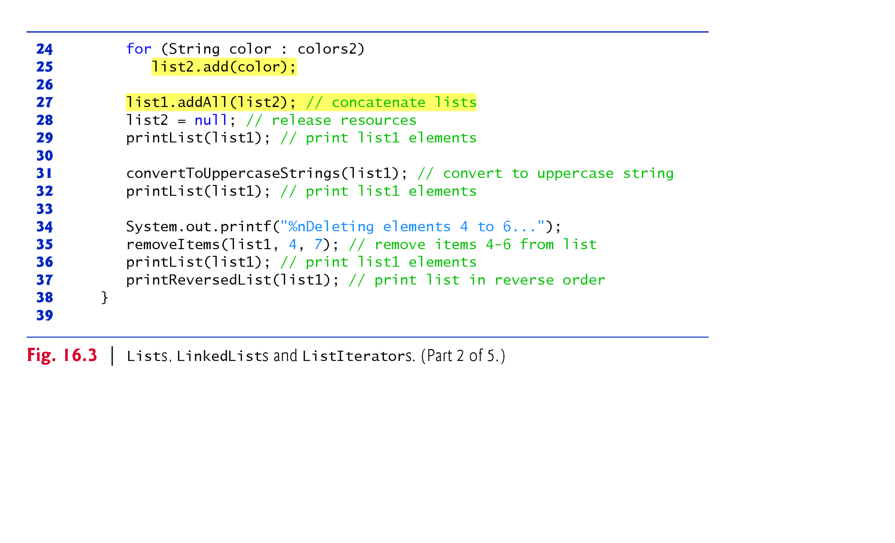
Example 2: Demo for Linked List(C) and Iterateor(I)

Slide 11
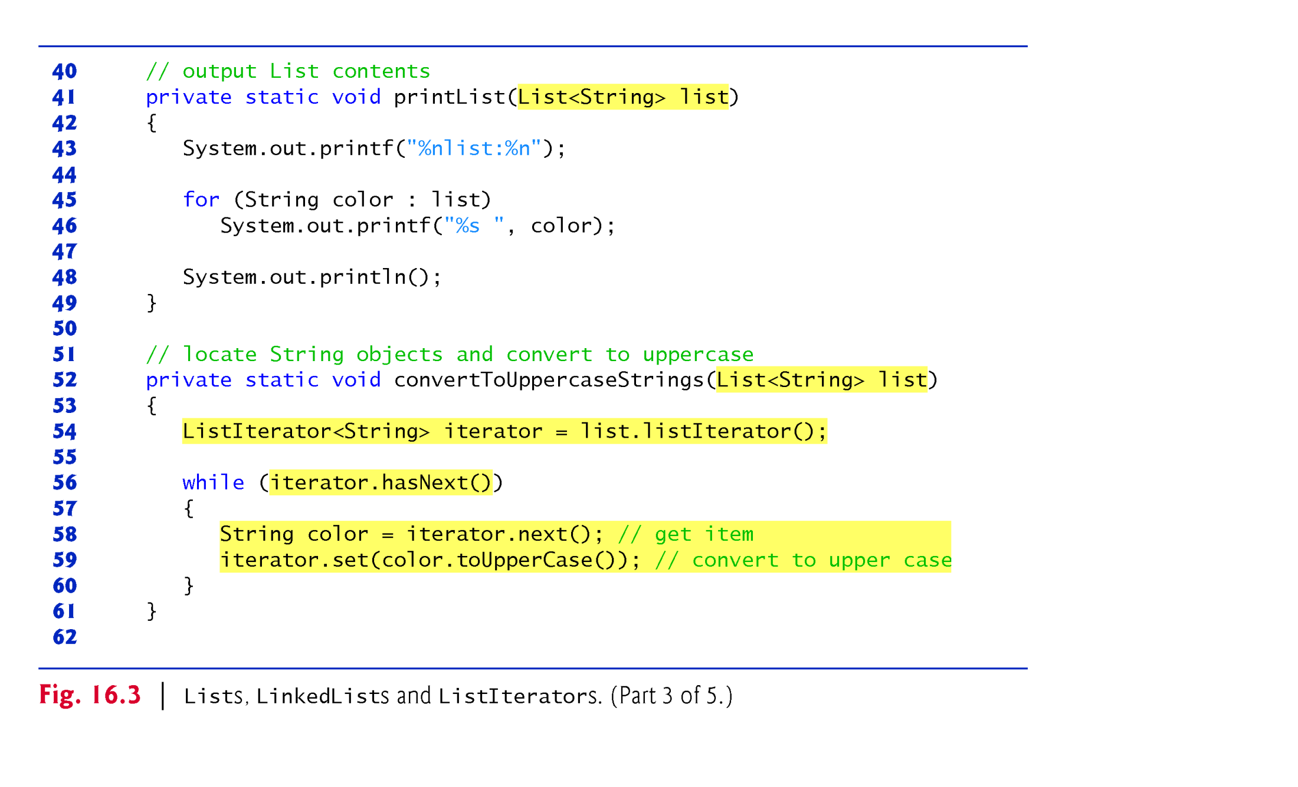
Example 2: Demo for Linked List(C) and Iterateor(I)

Slide 12
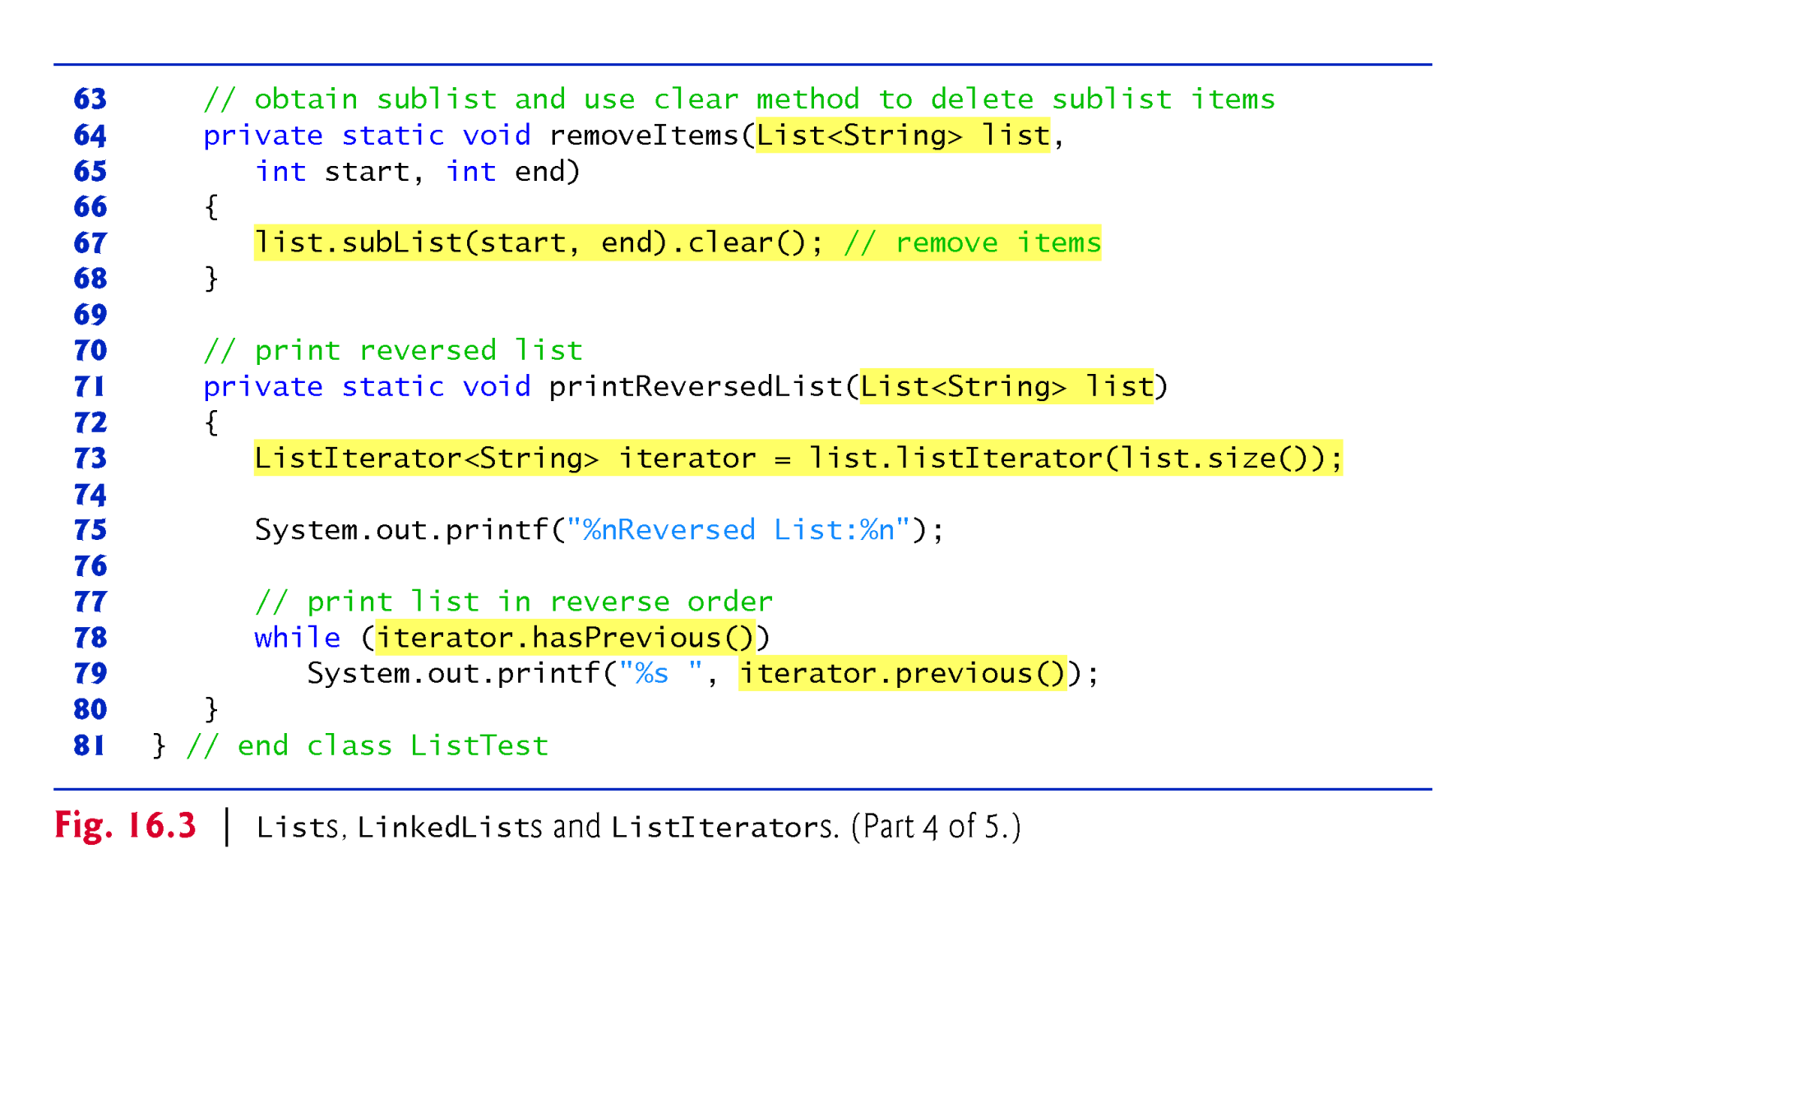
Example 2: Demo for Linked List(C) and Iterateor(I)

Slide 13
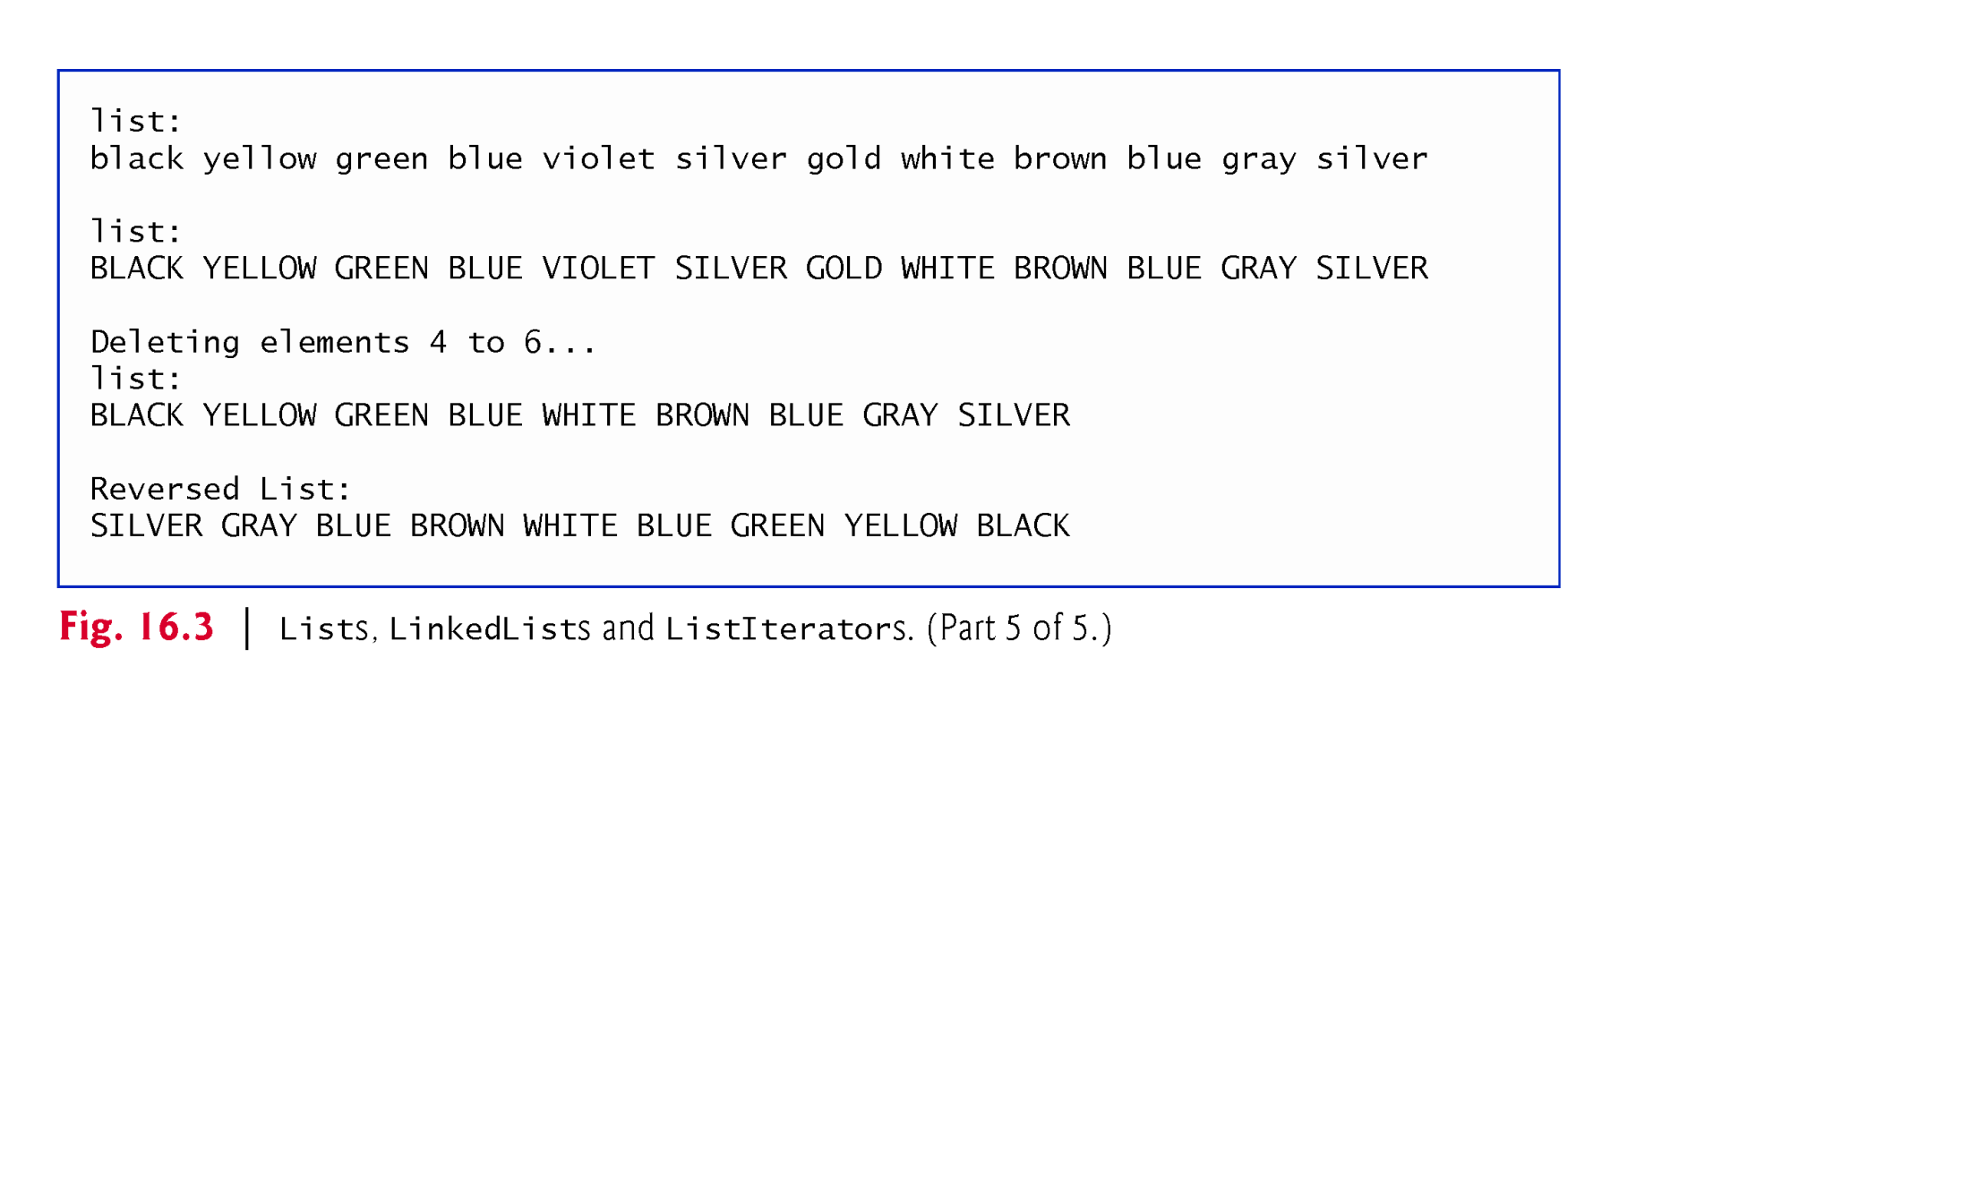
Example 2: Demo for Linked List(C) and Iterateor(I)

Slide 14
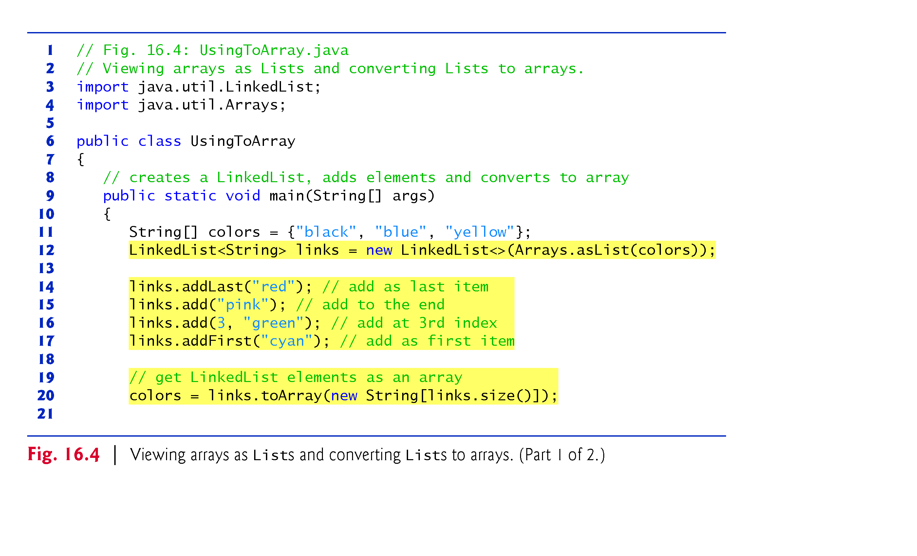
Example 3: normal array to List Vs List to normal array
Line 12: first normal array changed into list view, then used as argument to LinkedList
Line 20: normal array has fixed size. Hence, if the size of the Linkedlist is greater than the size of normal array, toArray() method resizes the normal array.

Slide 15
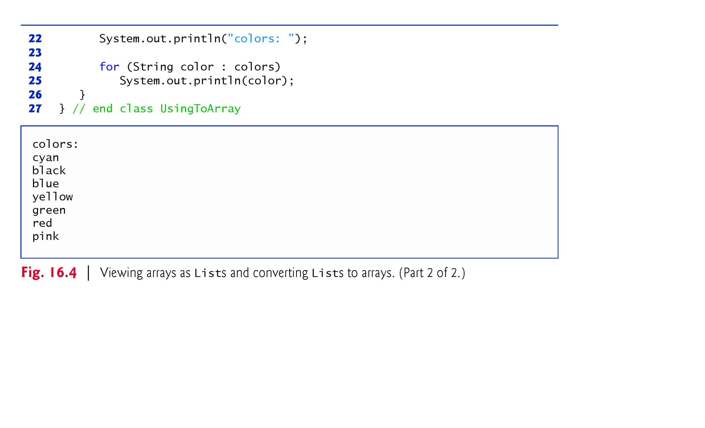
Example 3: : normal array to List Vs List to normal array
The asList() method of Arrays class enables us to view normal array as a List collection.
This view allows us to manipulate the normal array as if it were a list.

Slide 16
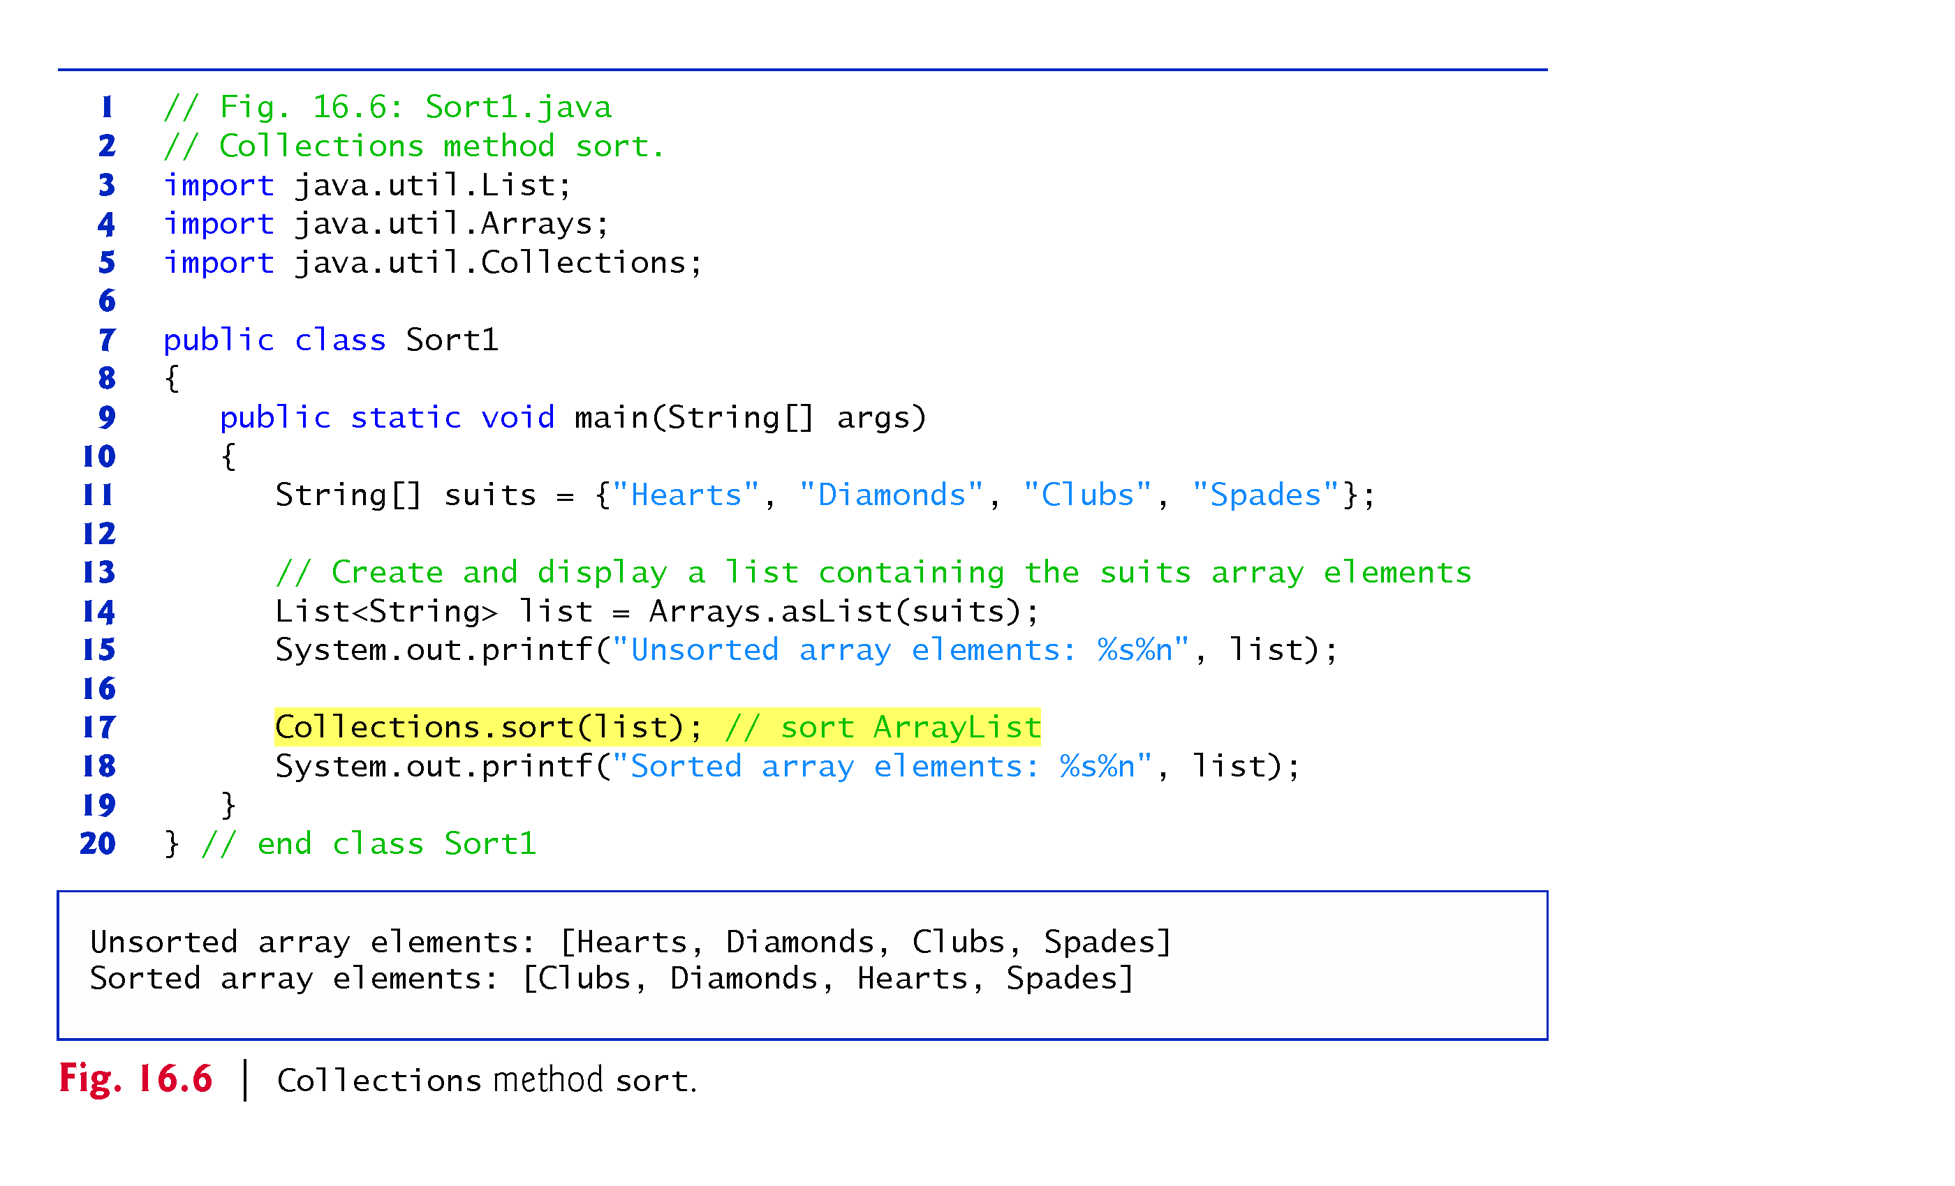
Example 4: Sorting list of Strings in ascending order

Slide 17
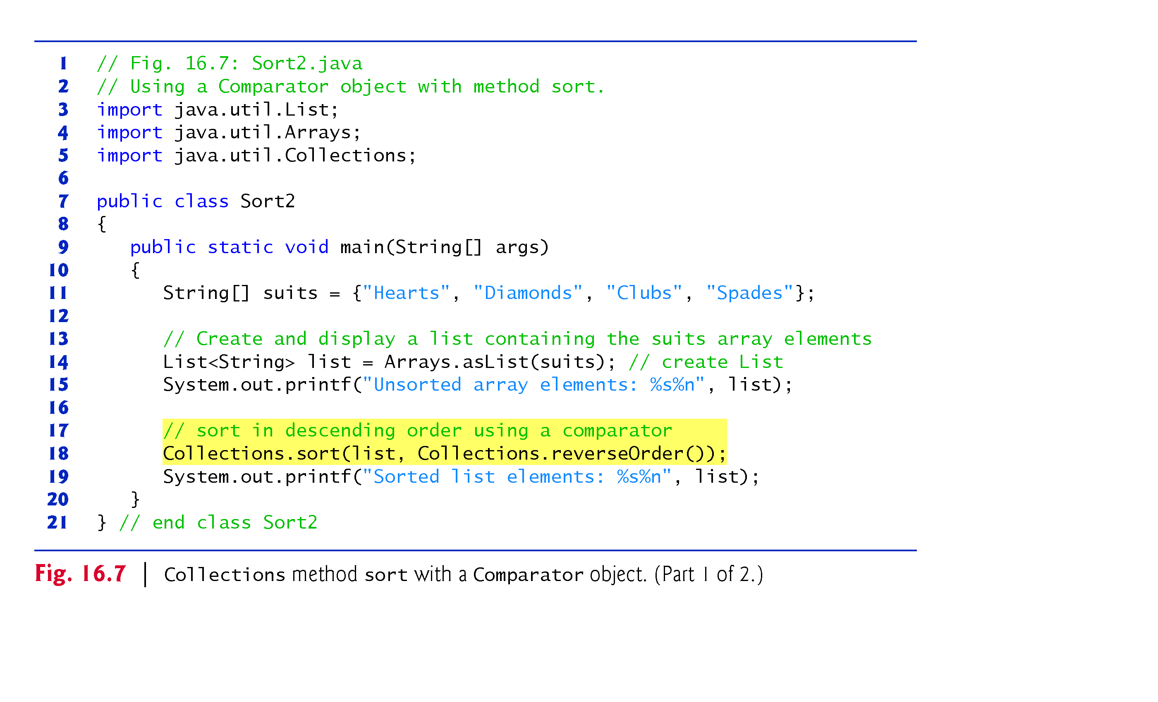
Example 5: Sorting list of Strings in Descending order

Slide 18
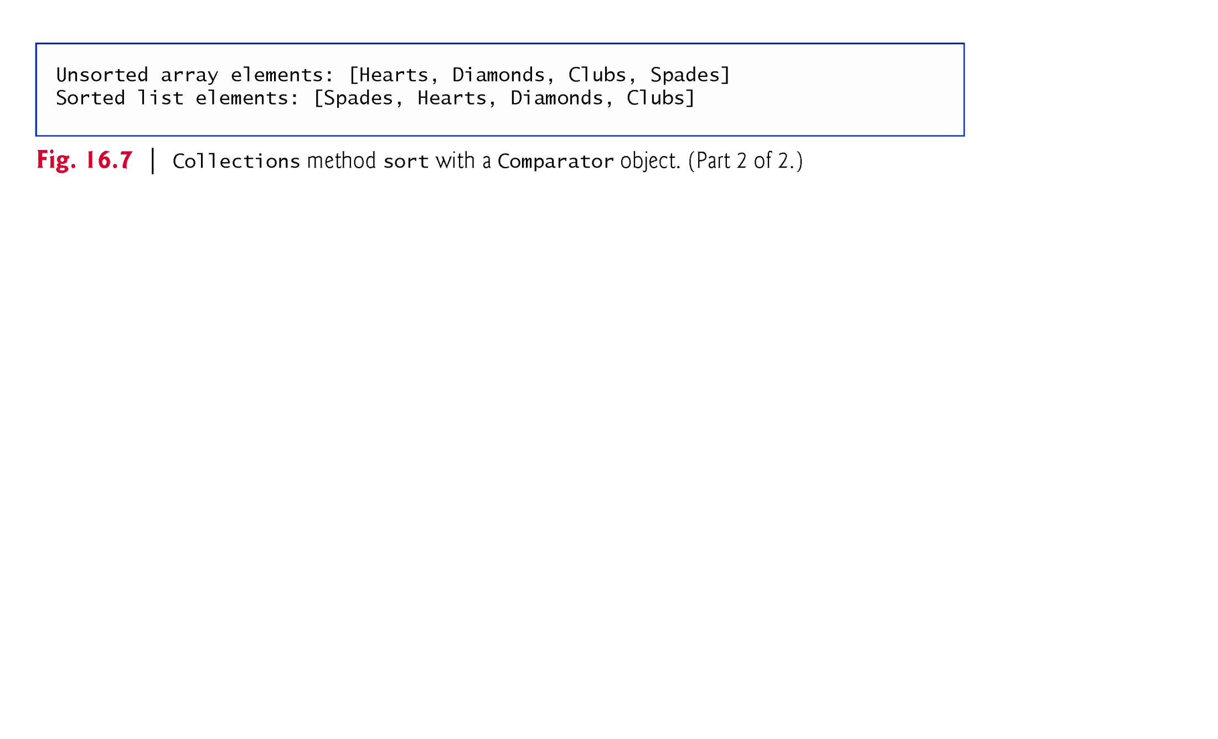
Example 5: Sorting list of Strings in Descending order

Slide 19
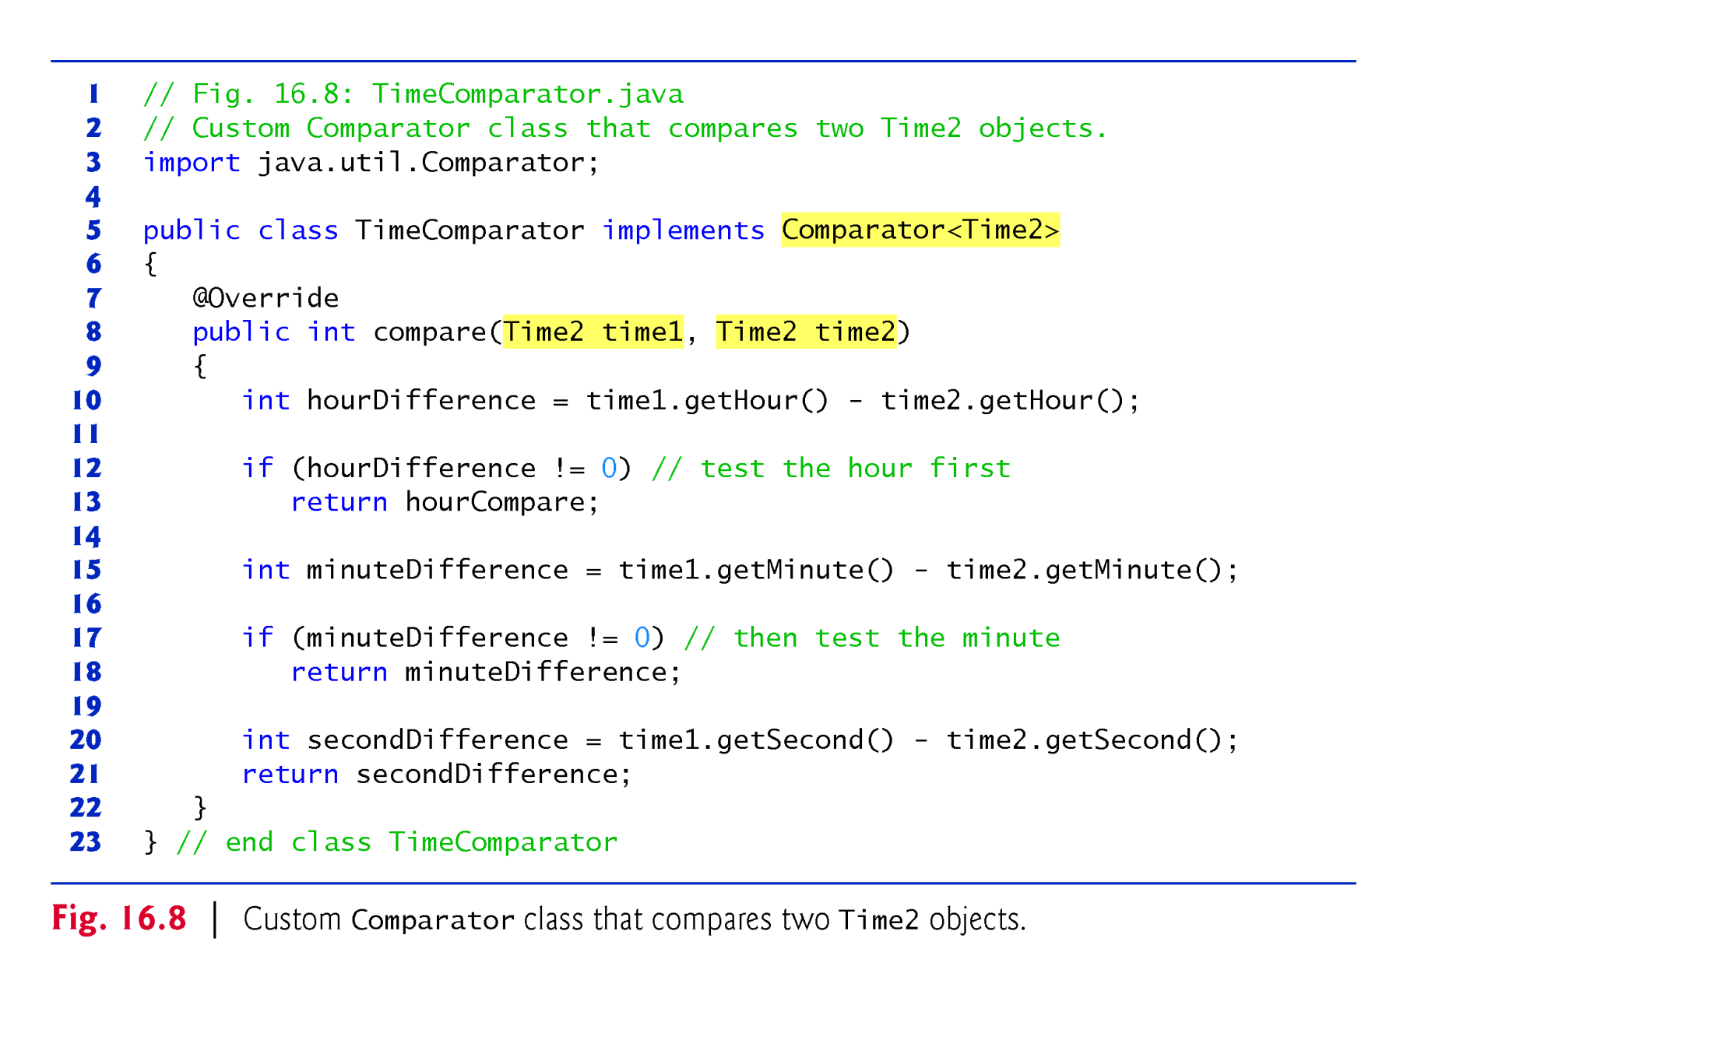
Example 6: Sorting list using customized Comparator
public class Time2 {
private int hour;
private int minute;
private int second ;
public class Time2( int hour, int minute , int hour {
this.hour= hour
this.minute=minute;
this.second=second;
}
}
Part 1: customized Time Comparator as a server class for Sort 3 client class

Slide 20
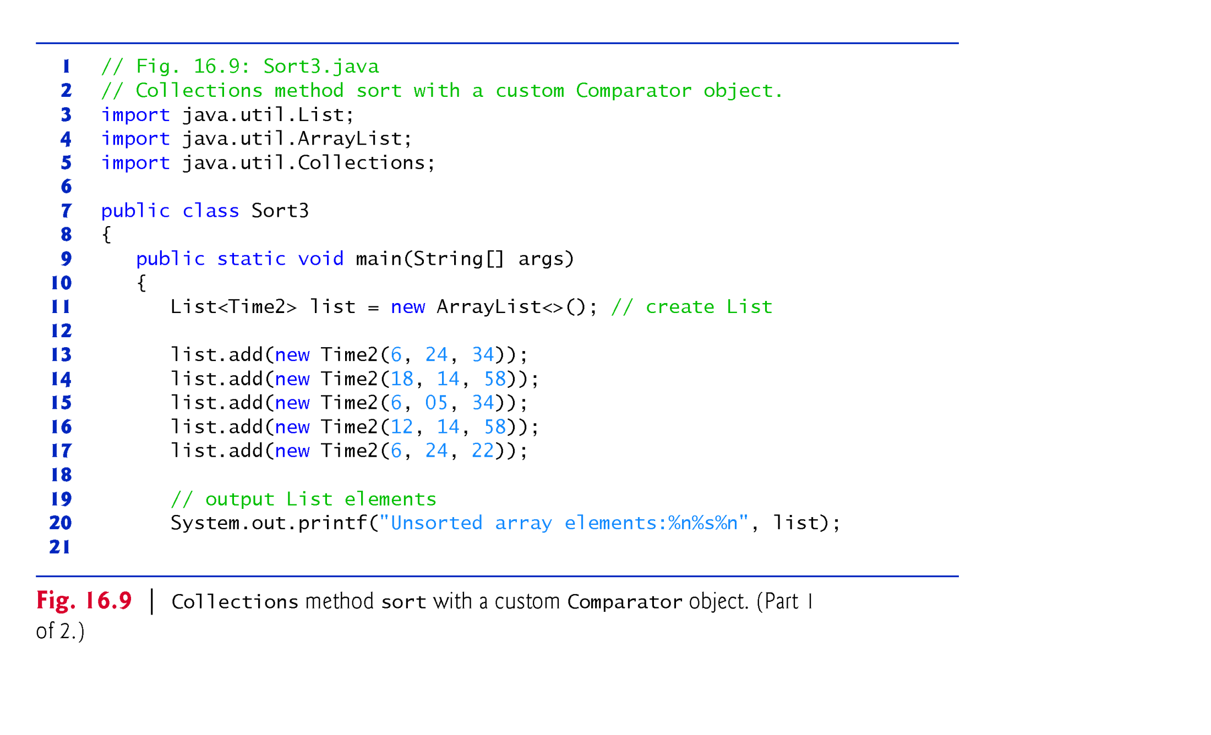
Example 6: Sorting using customized sorting order
Part 2: Sort 3 class as a client class for TimeComparator server class

Slide 21
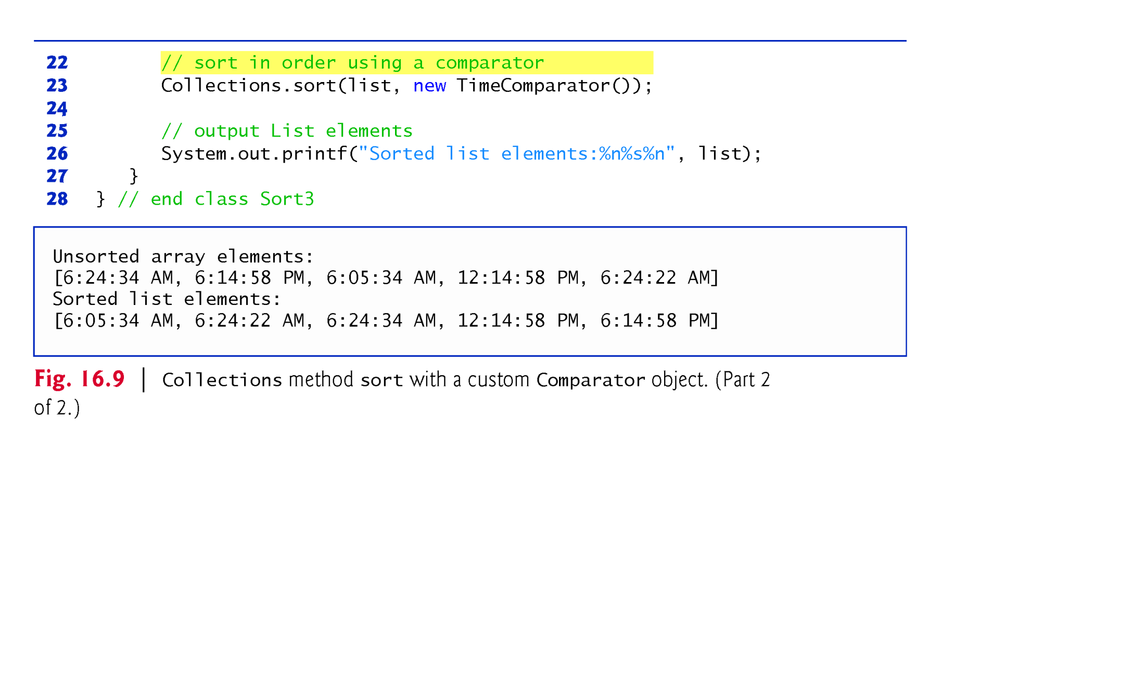
Example 6: Sorting using customized sorting order
TimeComparator class returns a negative integer if the first argument is less than the second, 0 if the arguments are equal or a positive integer if the first argument is greater than the second.

Slide 22
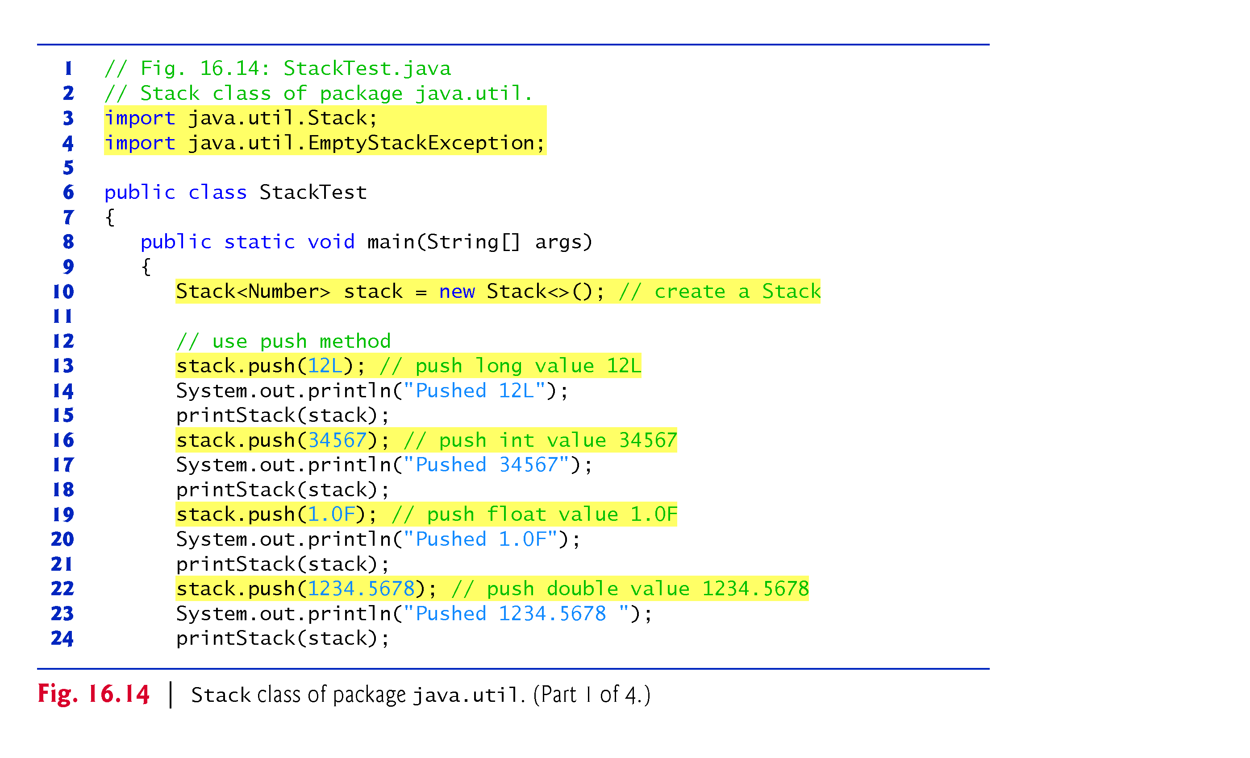
Example 7: Demo for stack class

Slide 23
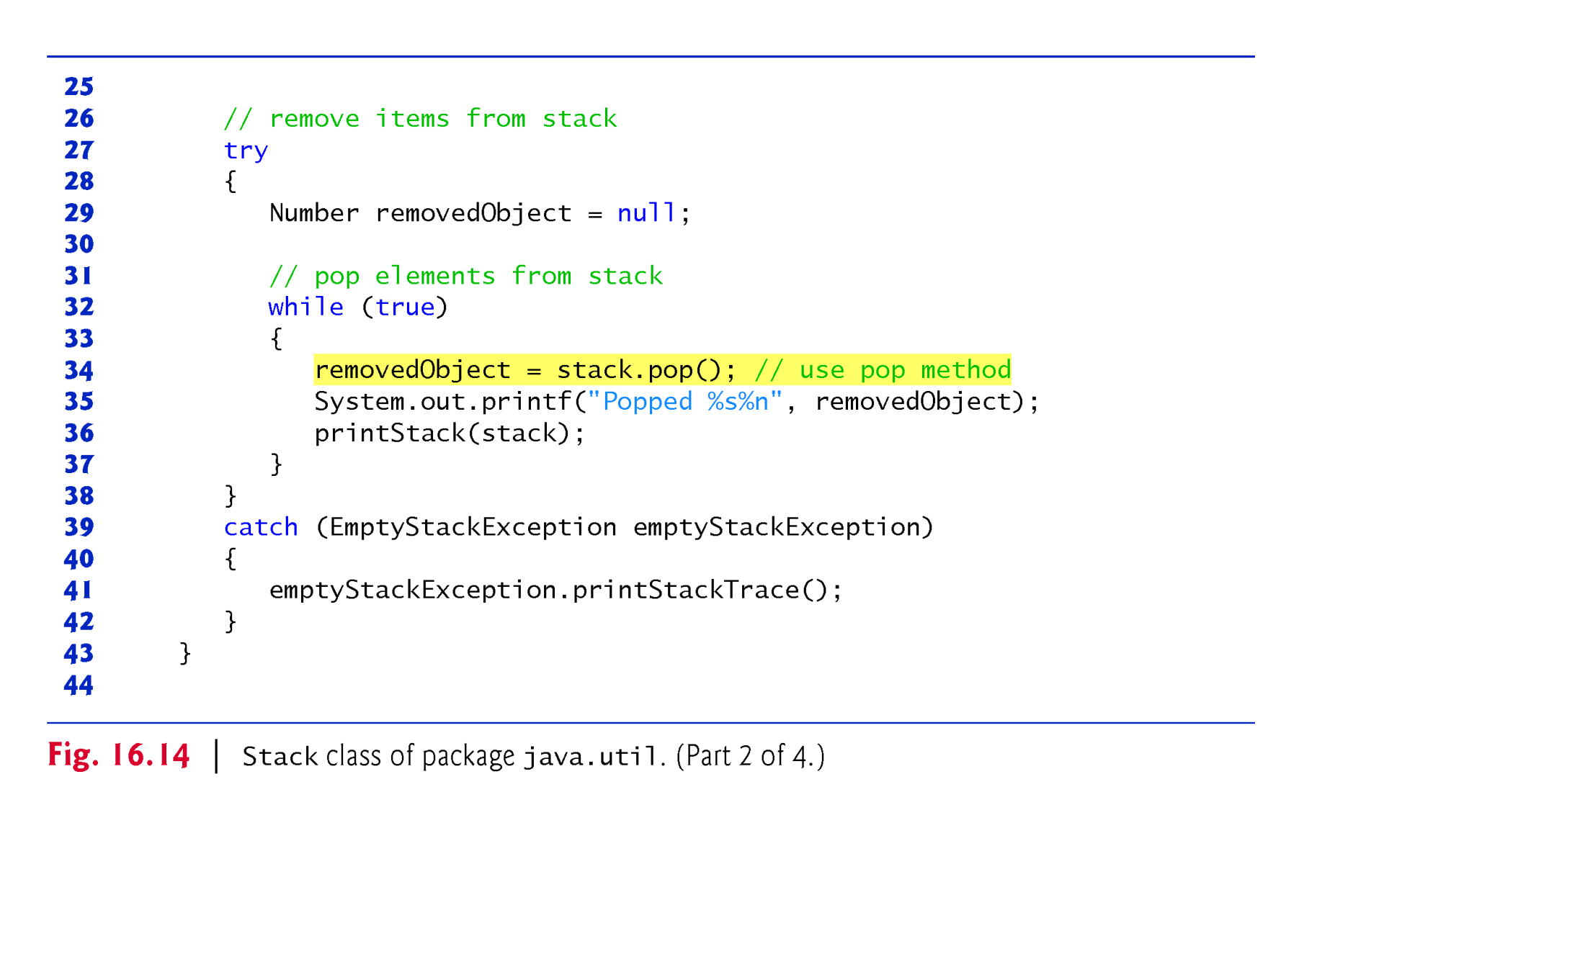
Example 7: Demo for stack class

Slide 24
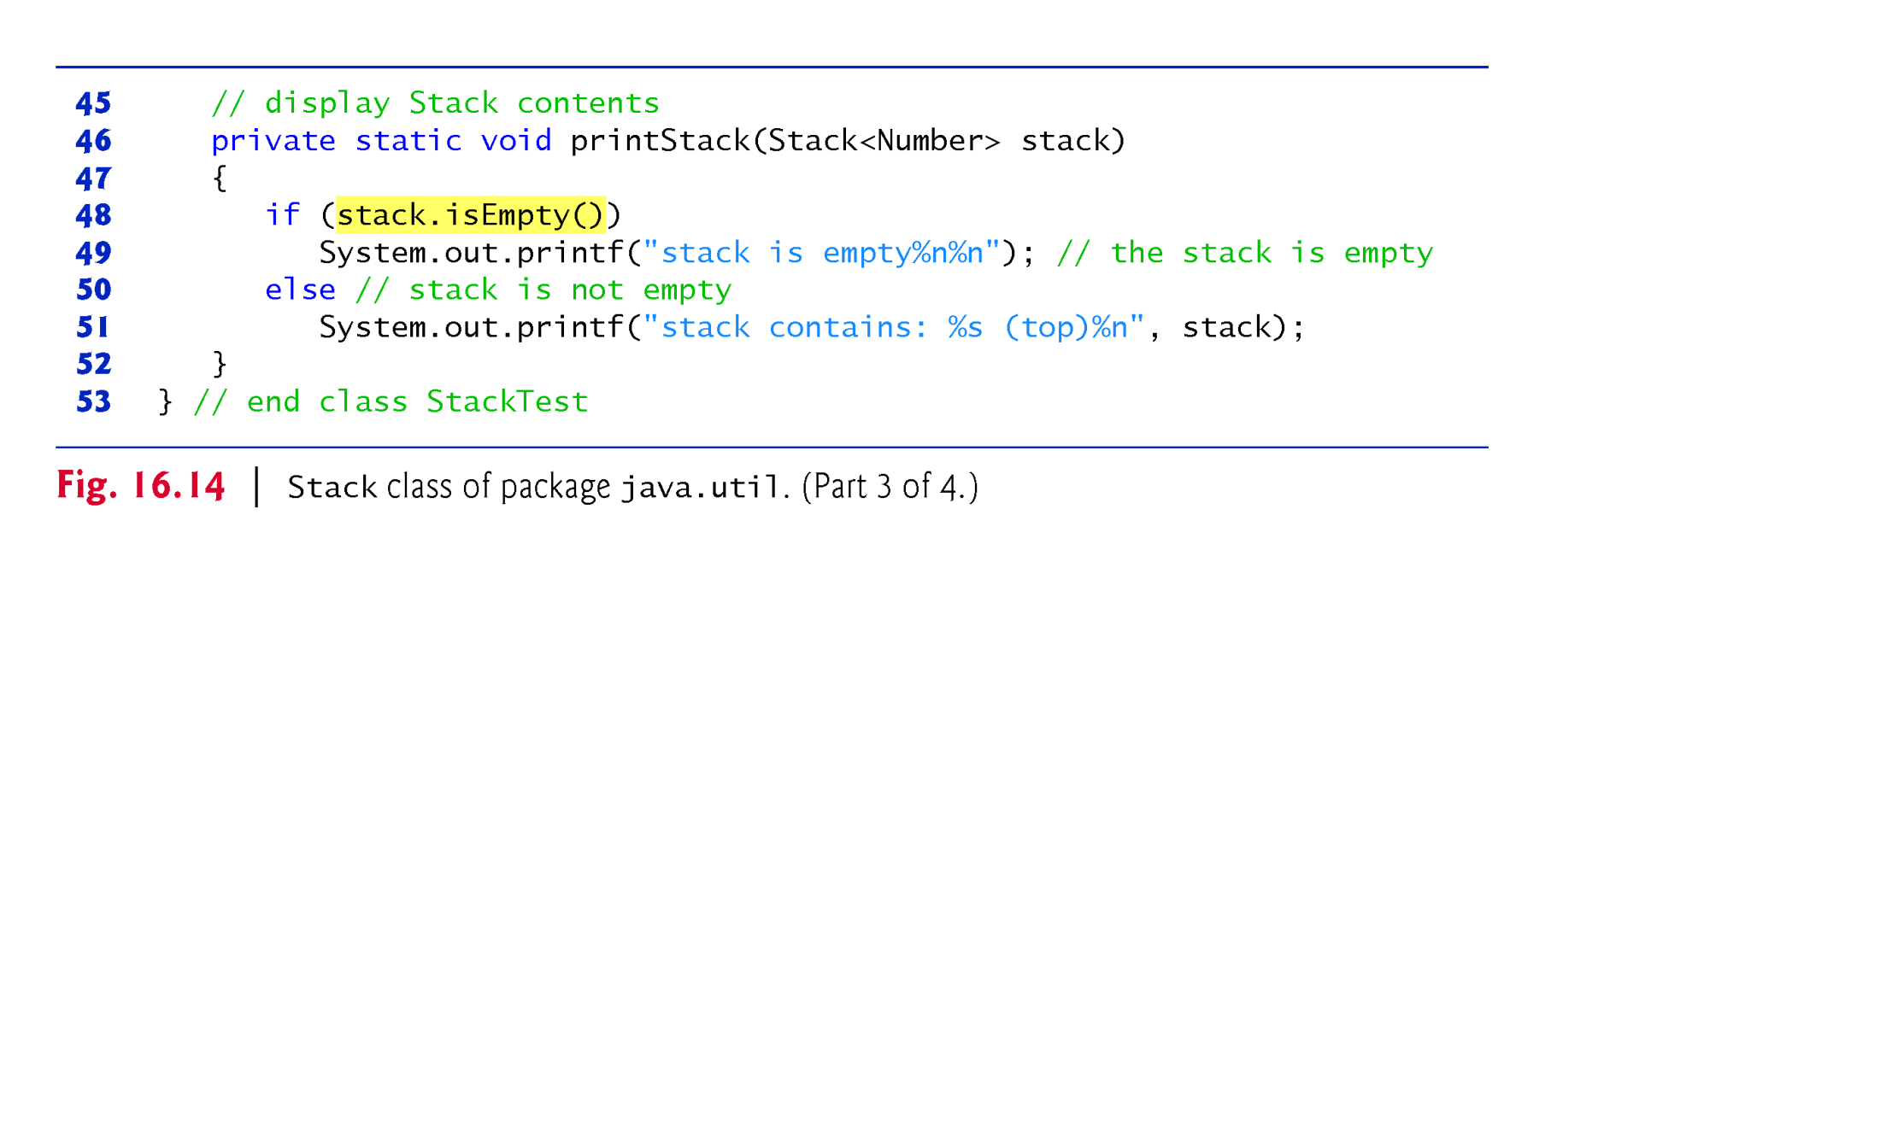
Example 7: Demo for stack class

Slide 25
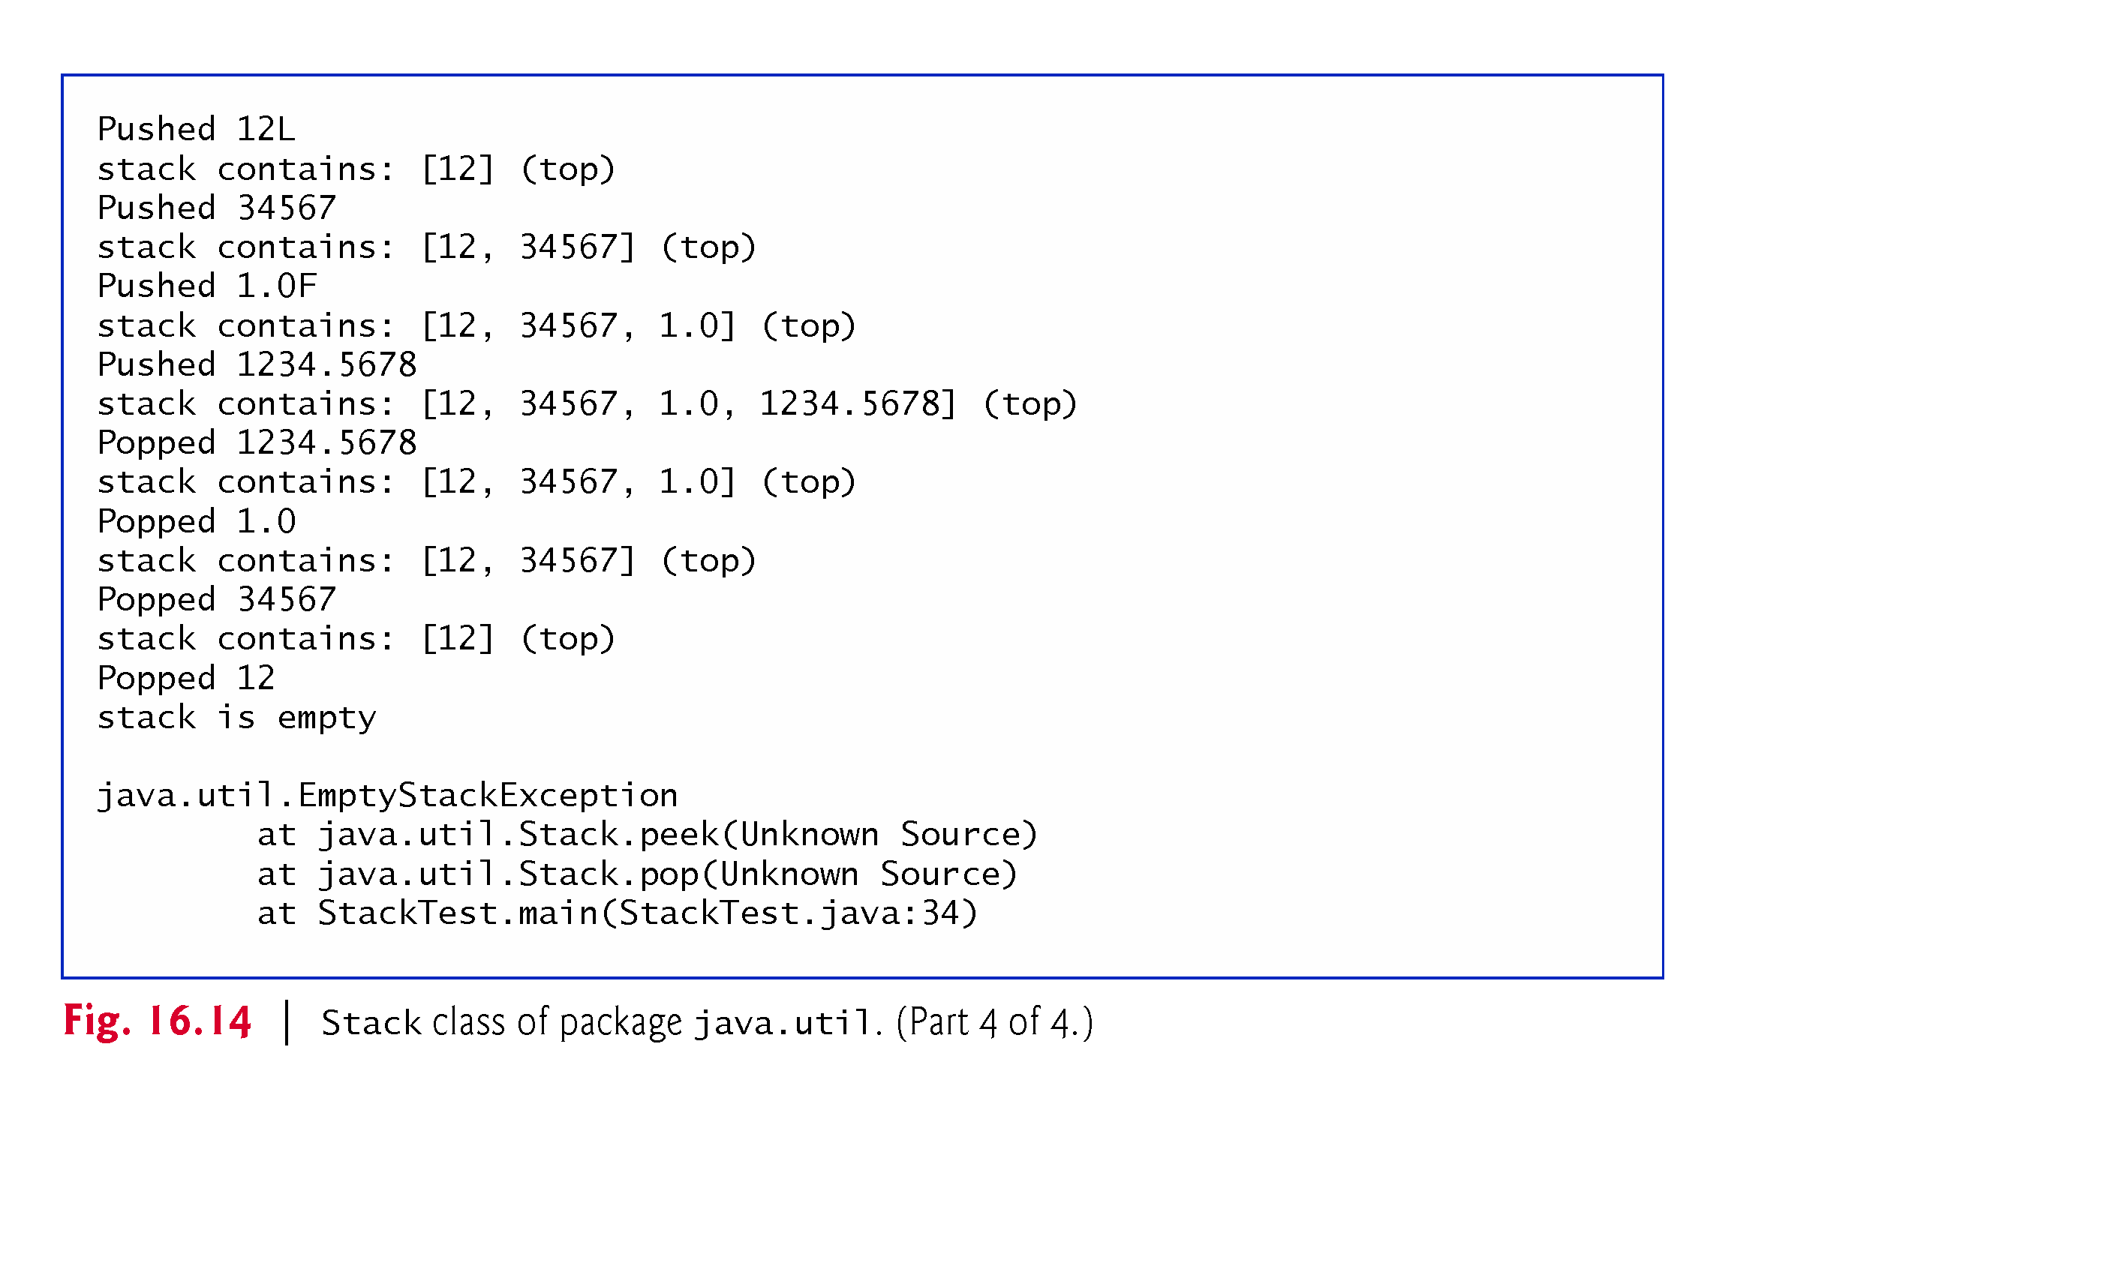
Example 7: Demo for stack class

Slide 26
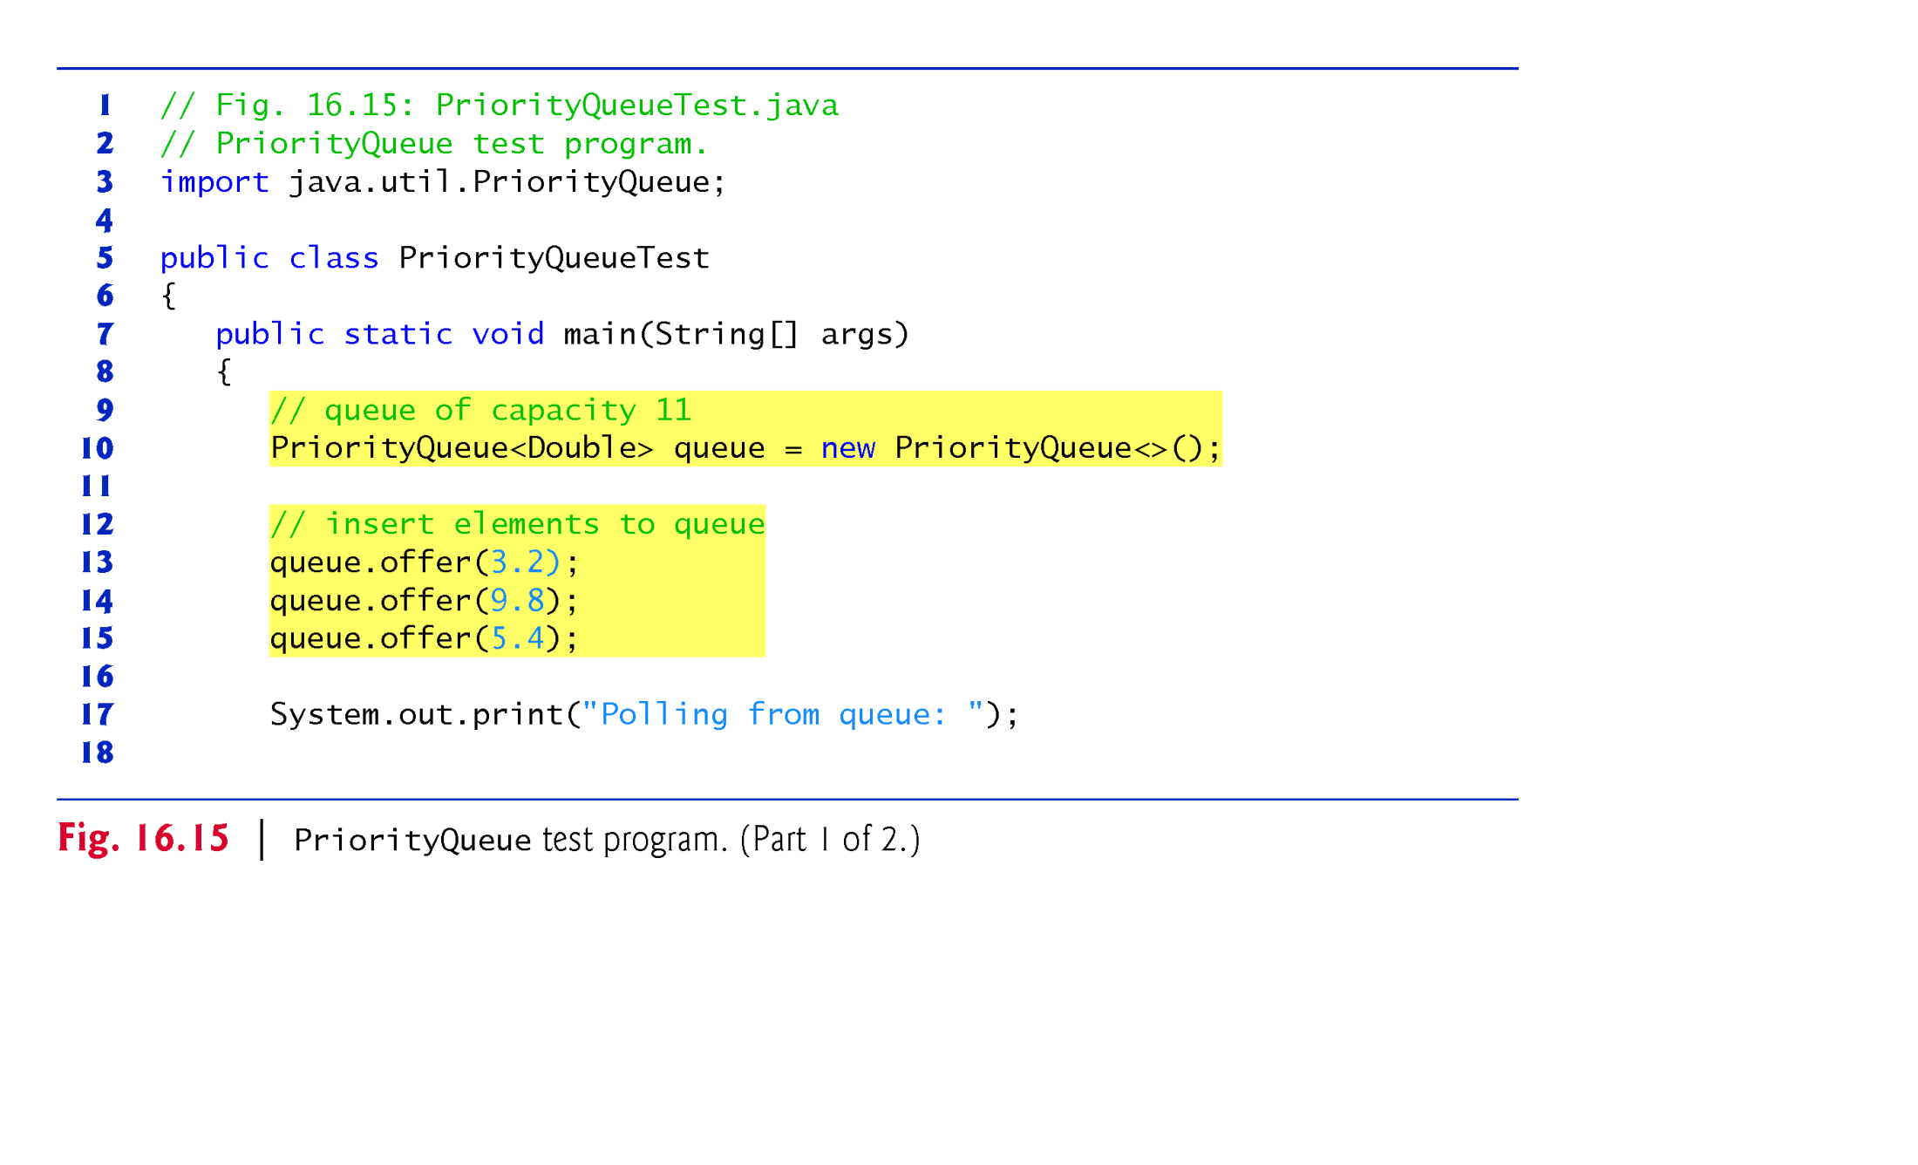
Example 8: Demo for Priority queue class

Slide 27
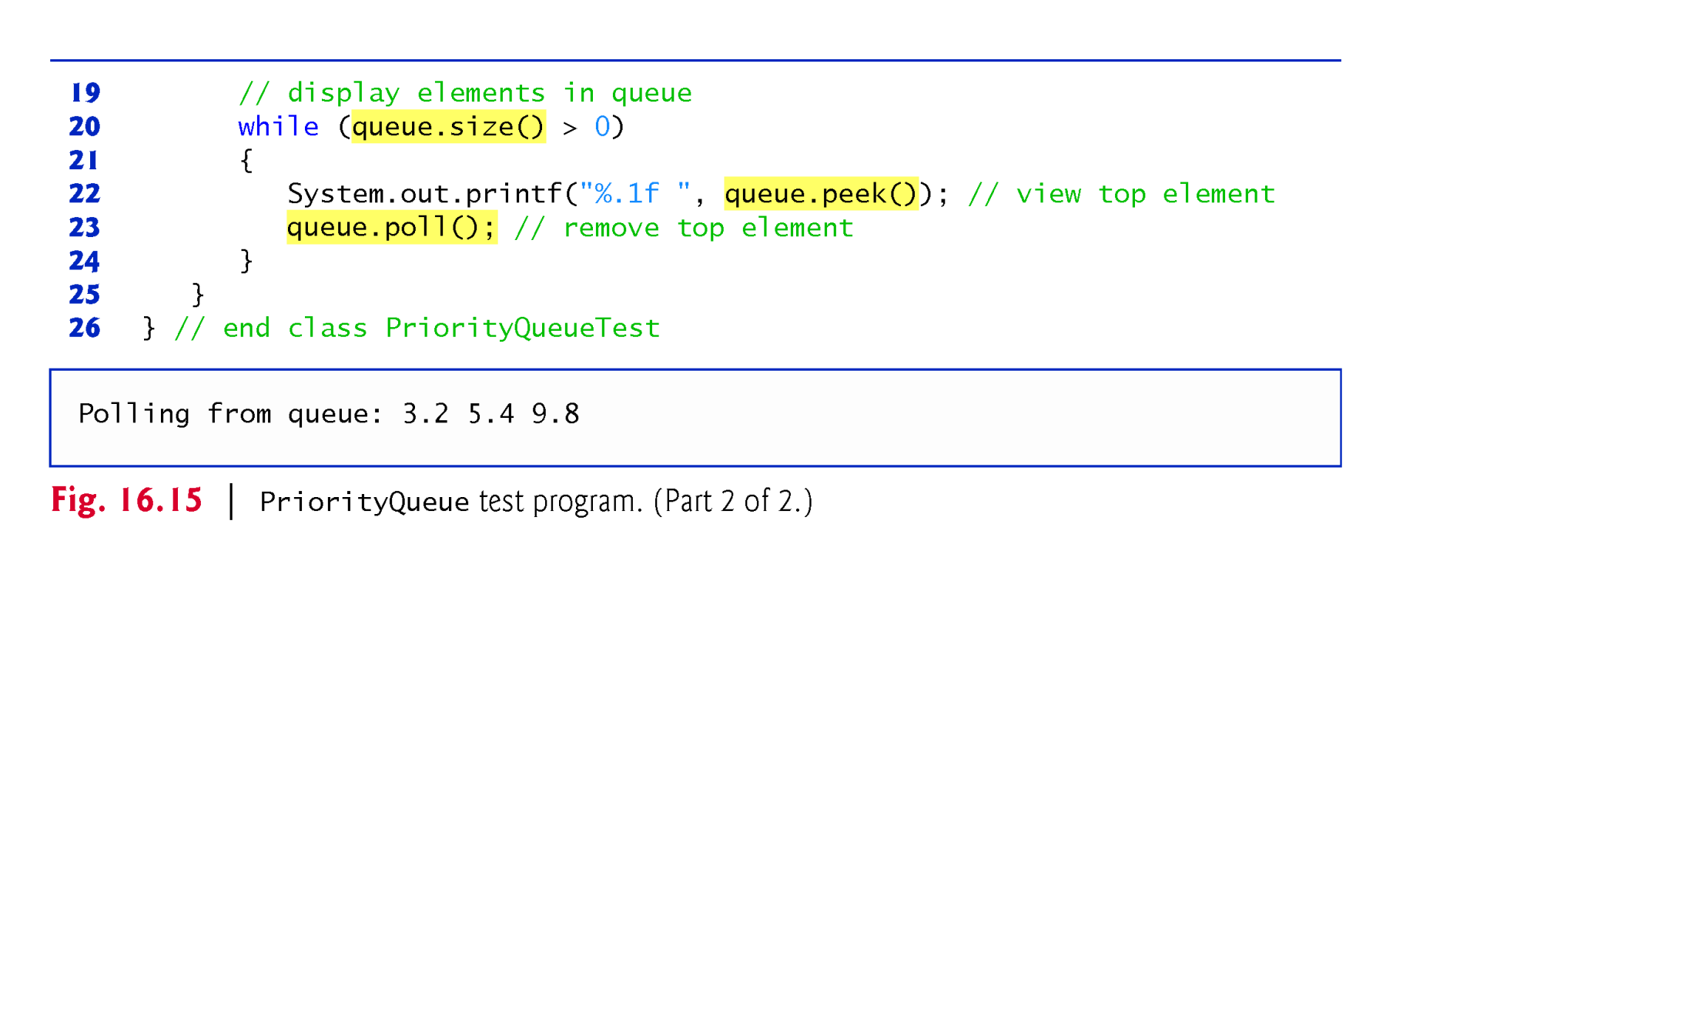
Example 8: Demo for Priority queue class

Slide 28
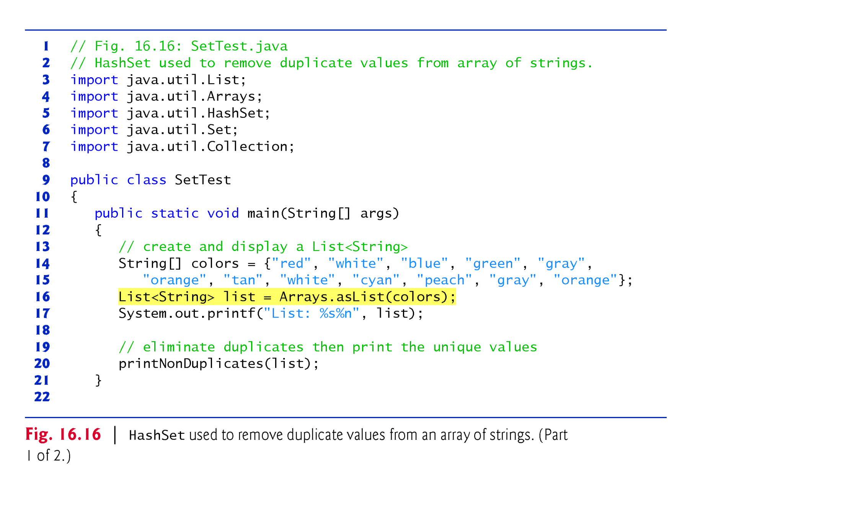
Example 9. Demo HashSet class

Slide 29
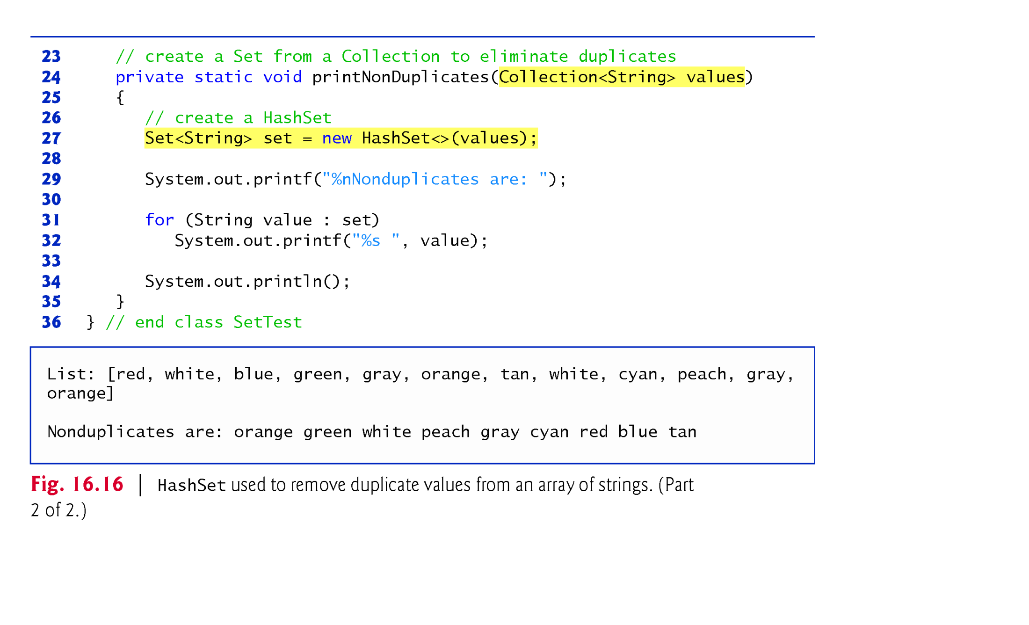
Example 9. Demo HashSet class

Slide 30
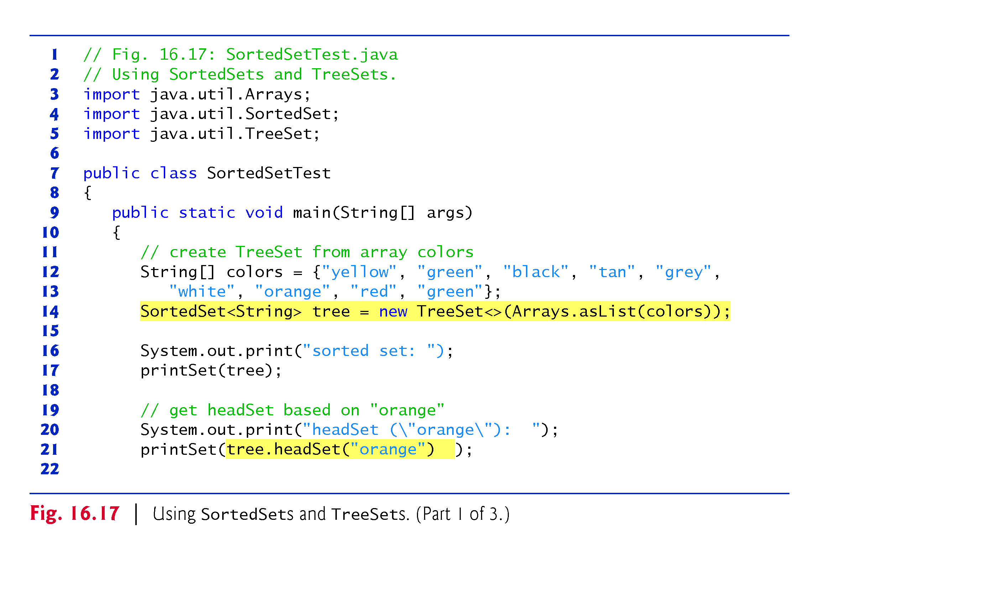
Example 10 . Demo TreeSet class

Slide 31
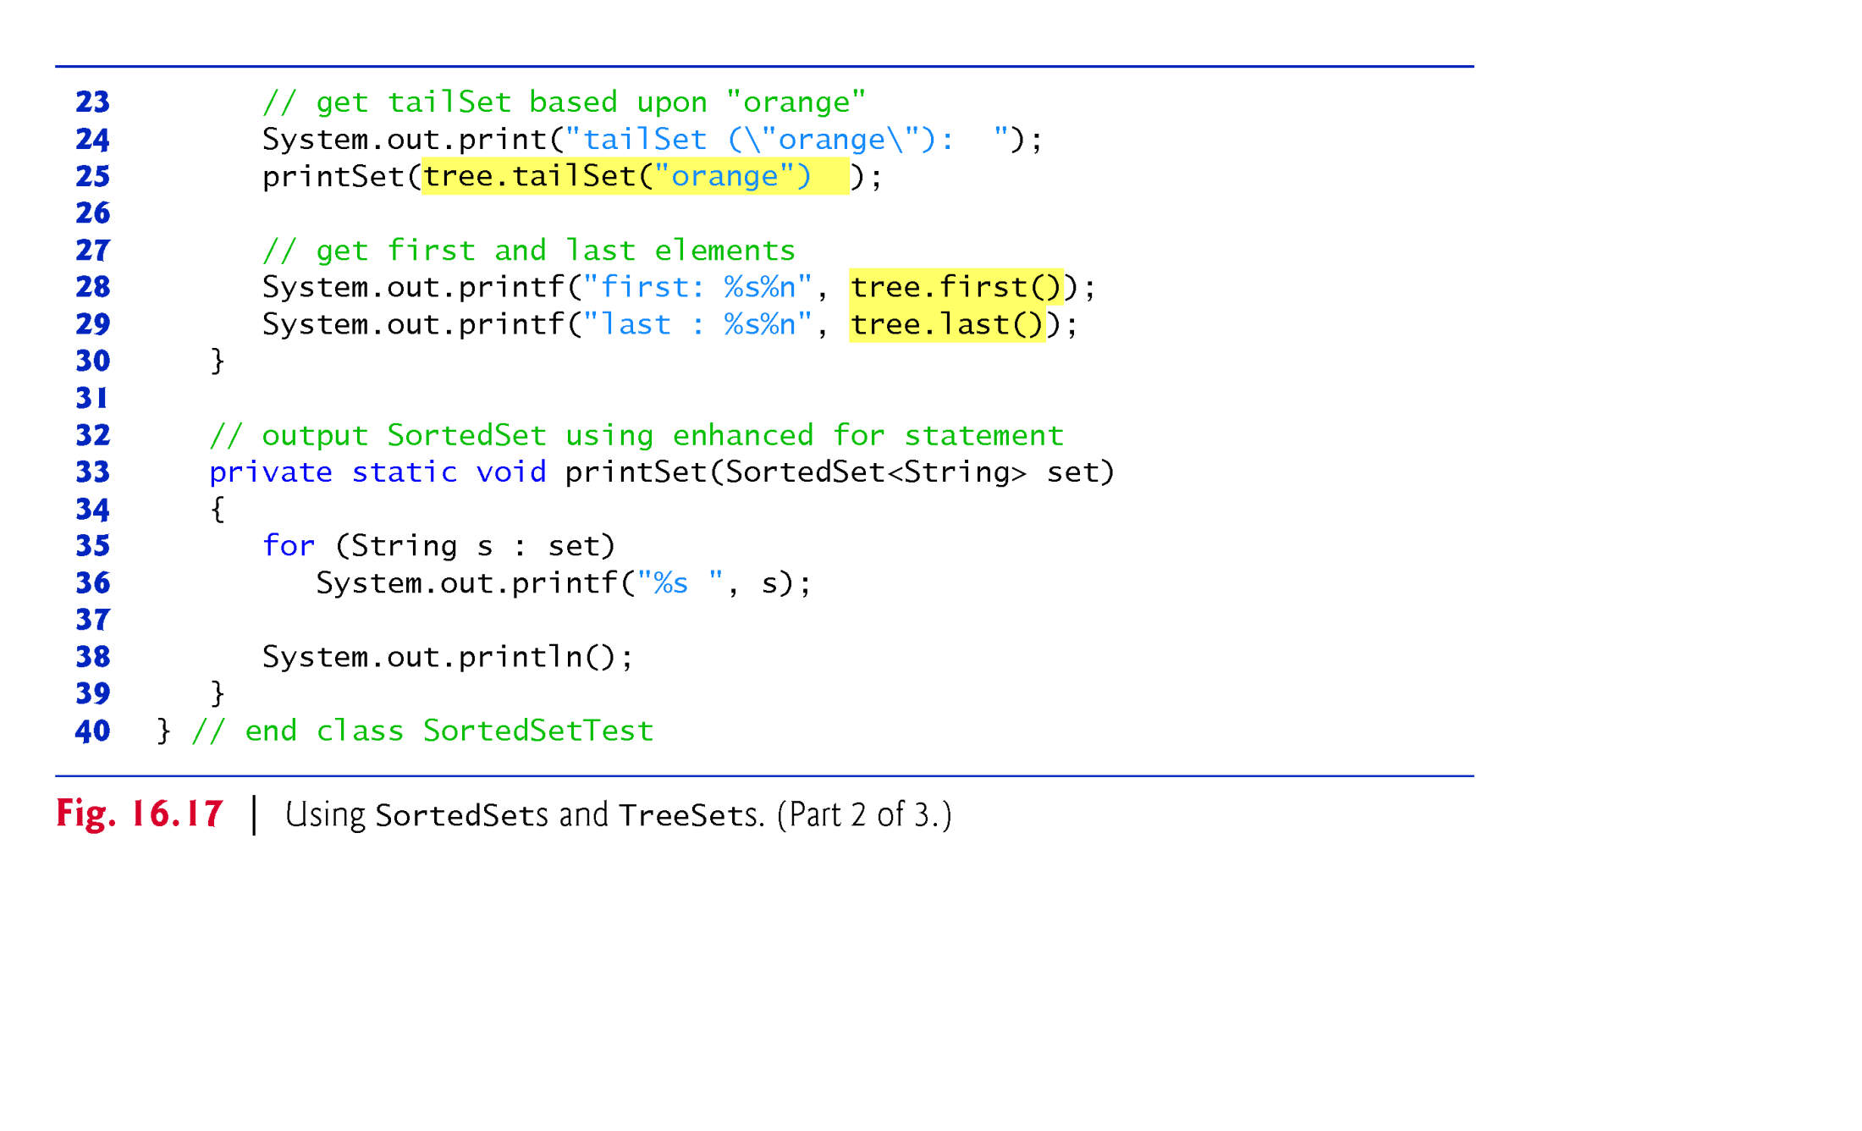
Example 10 . Demo TreeSet class

Slide 32
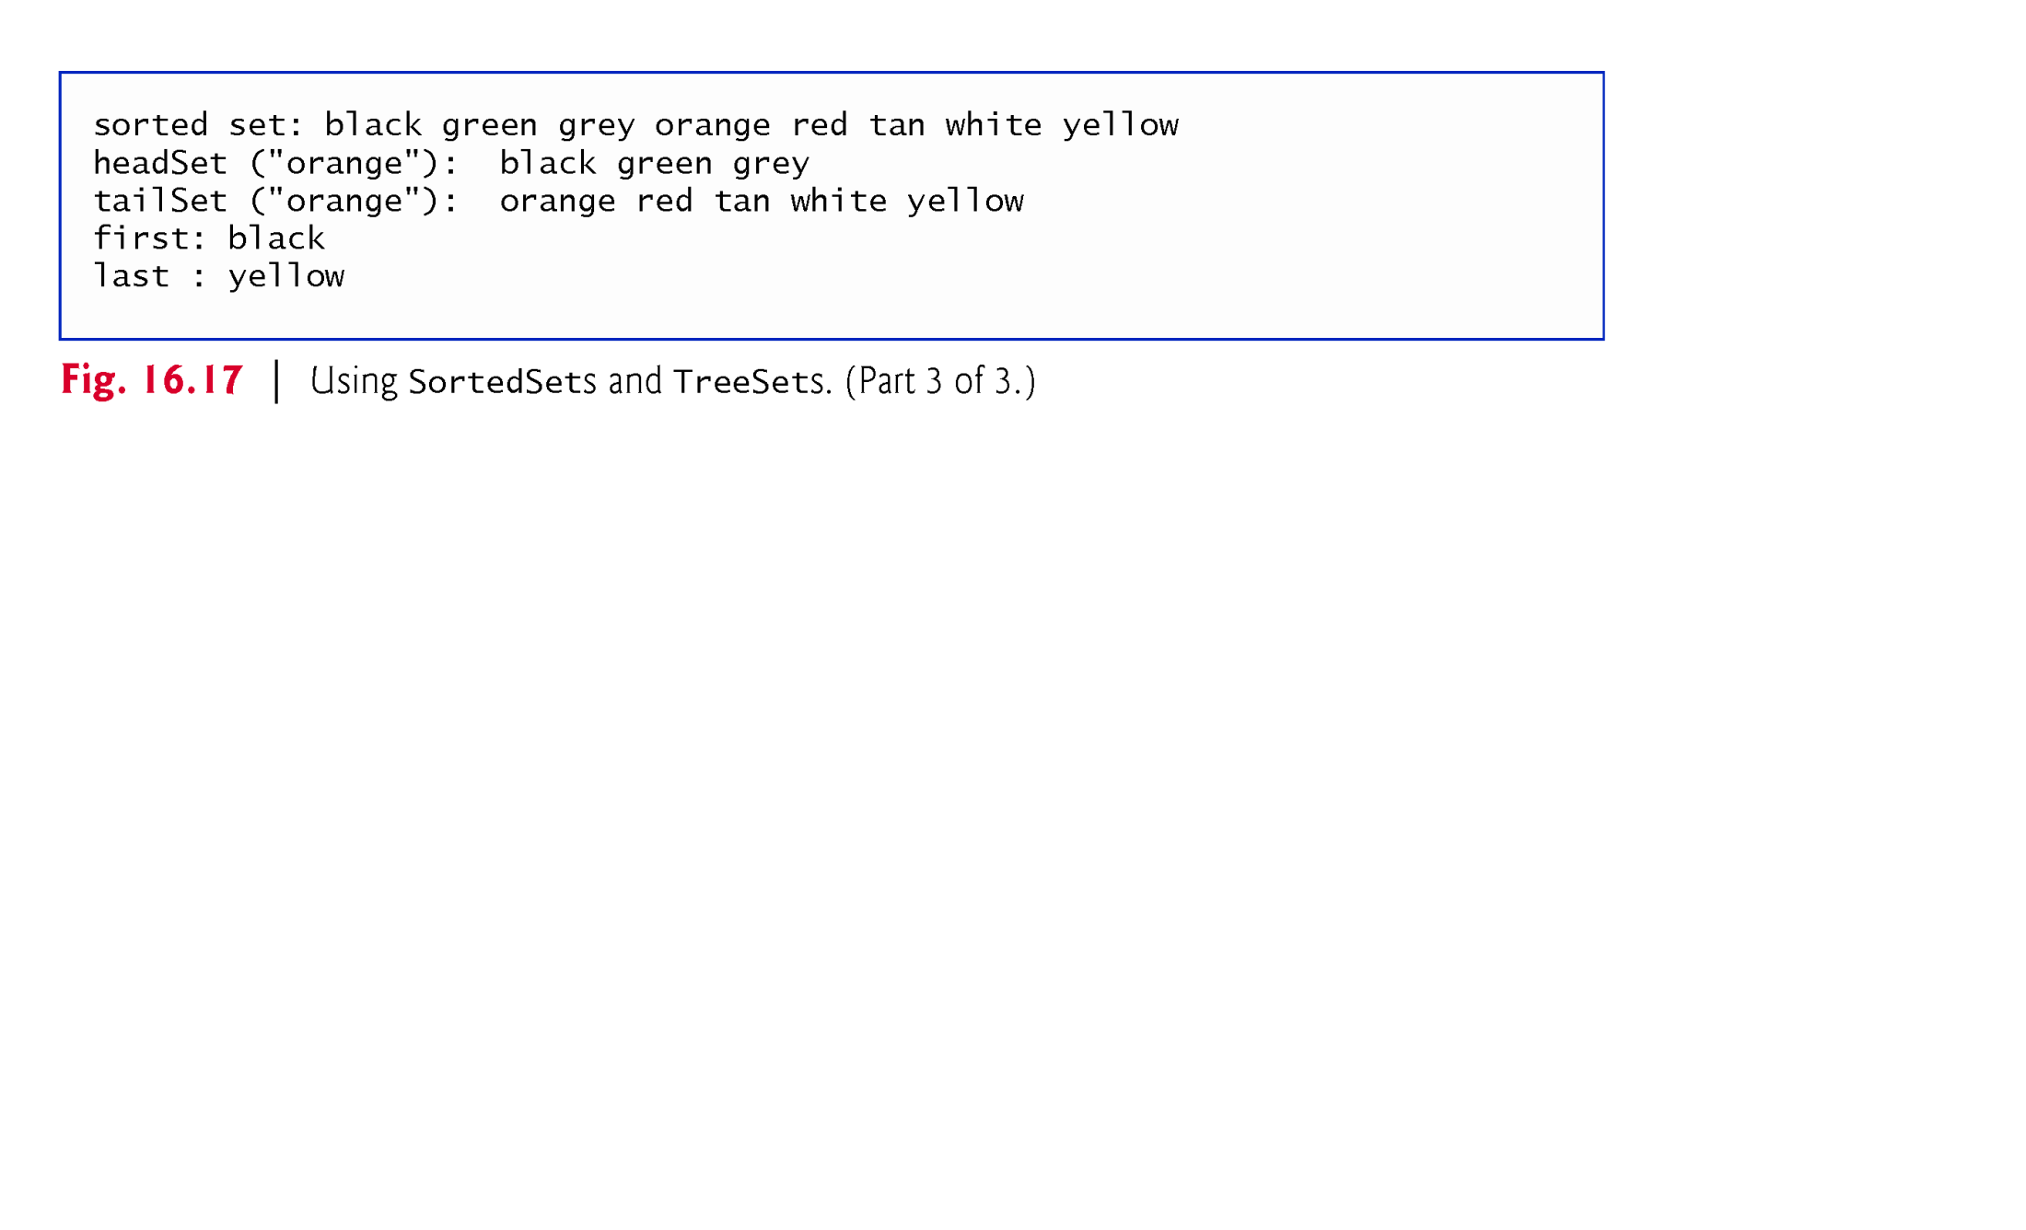
Example 10 . Demo TreeSet class

Slide 33
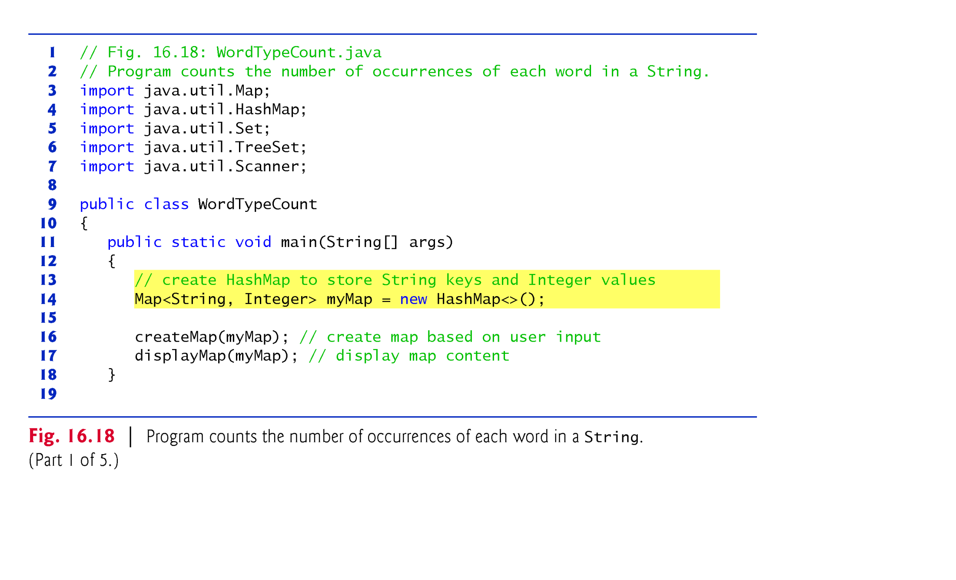
Example 11 . Demo HashMap class
This program generates frequency of words

Slide 34
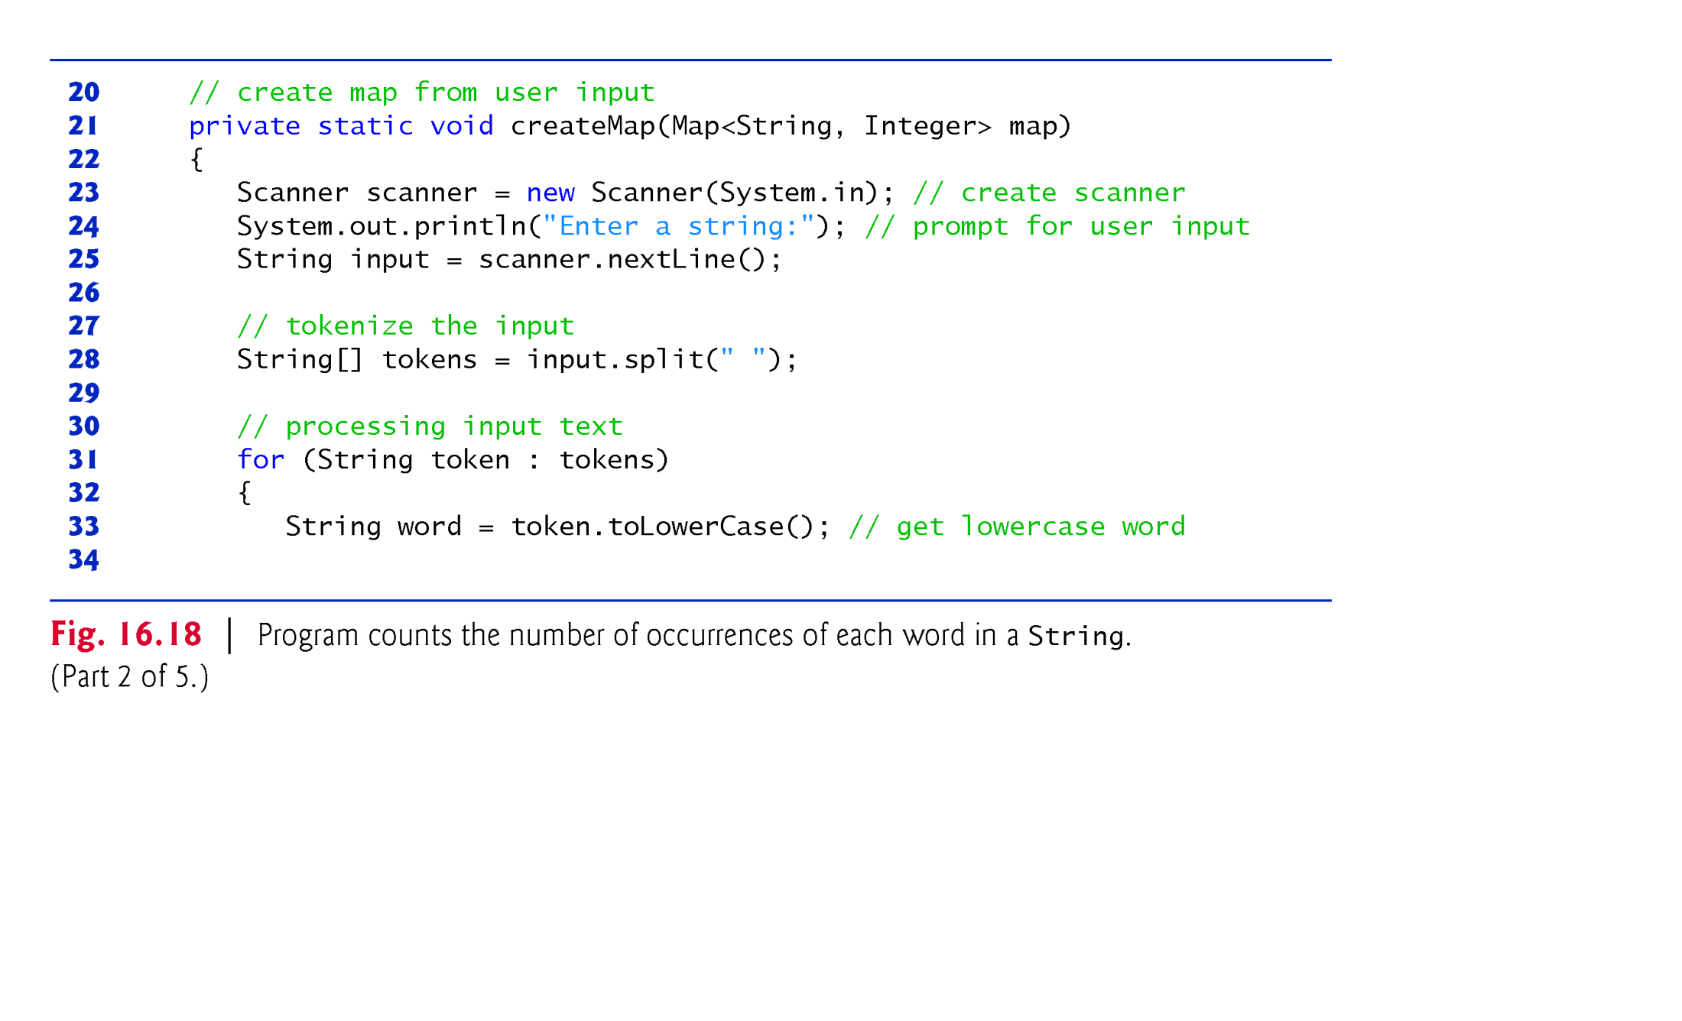
Example 11 . Demo HashMap class

Slide 35
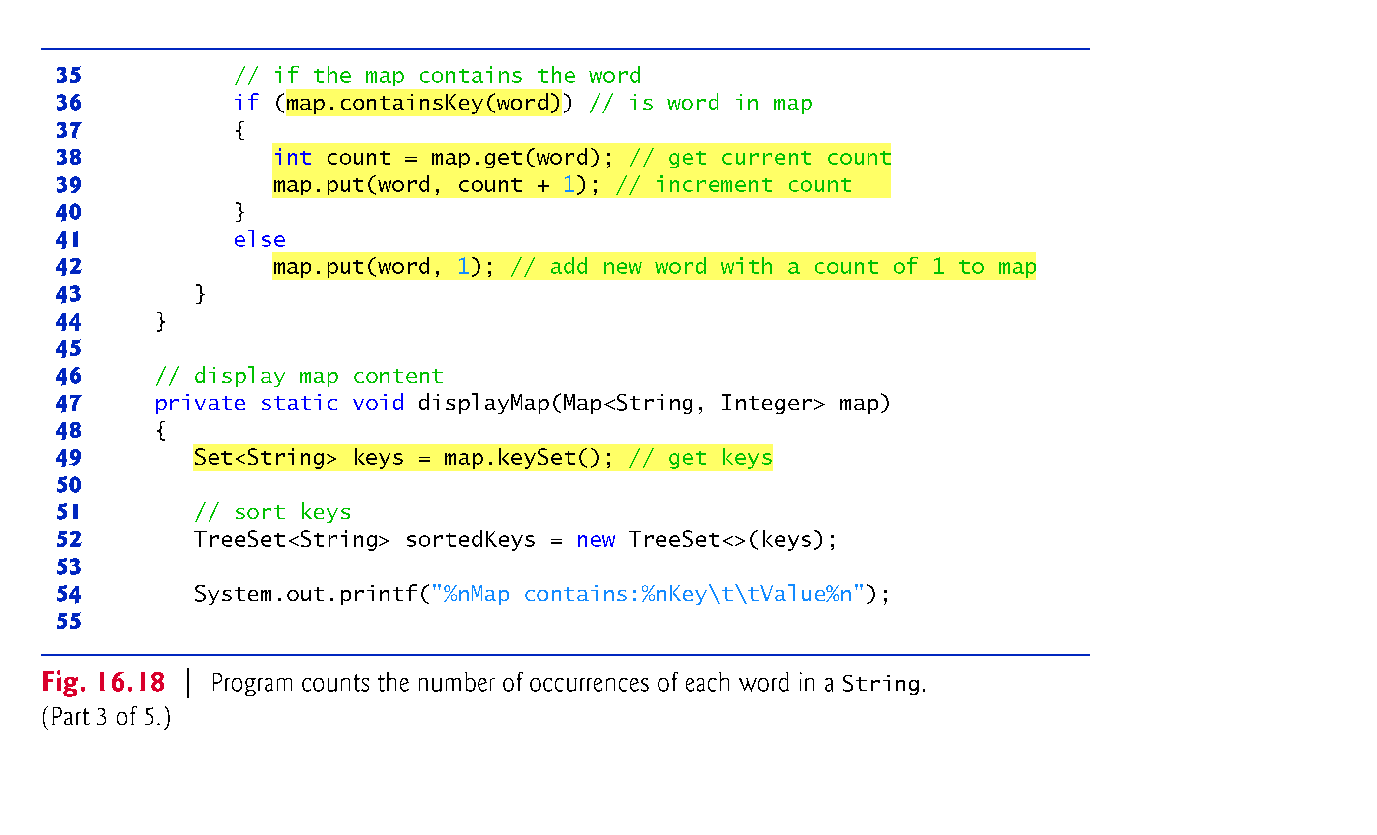
Example 11 . Demo HashMap class

Slide 36
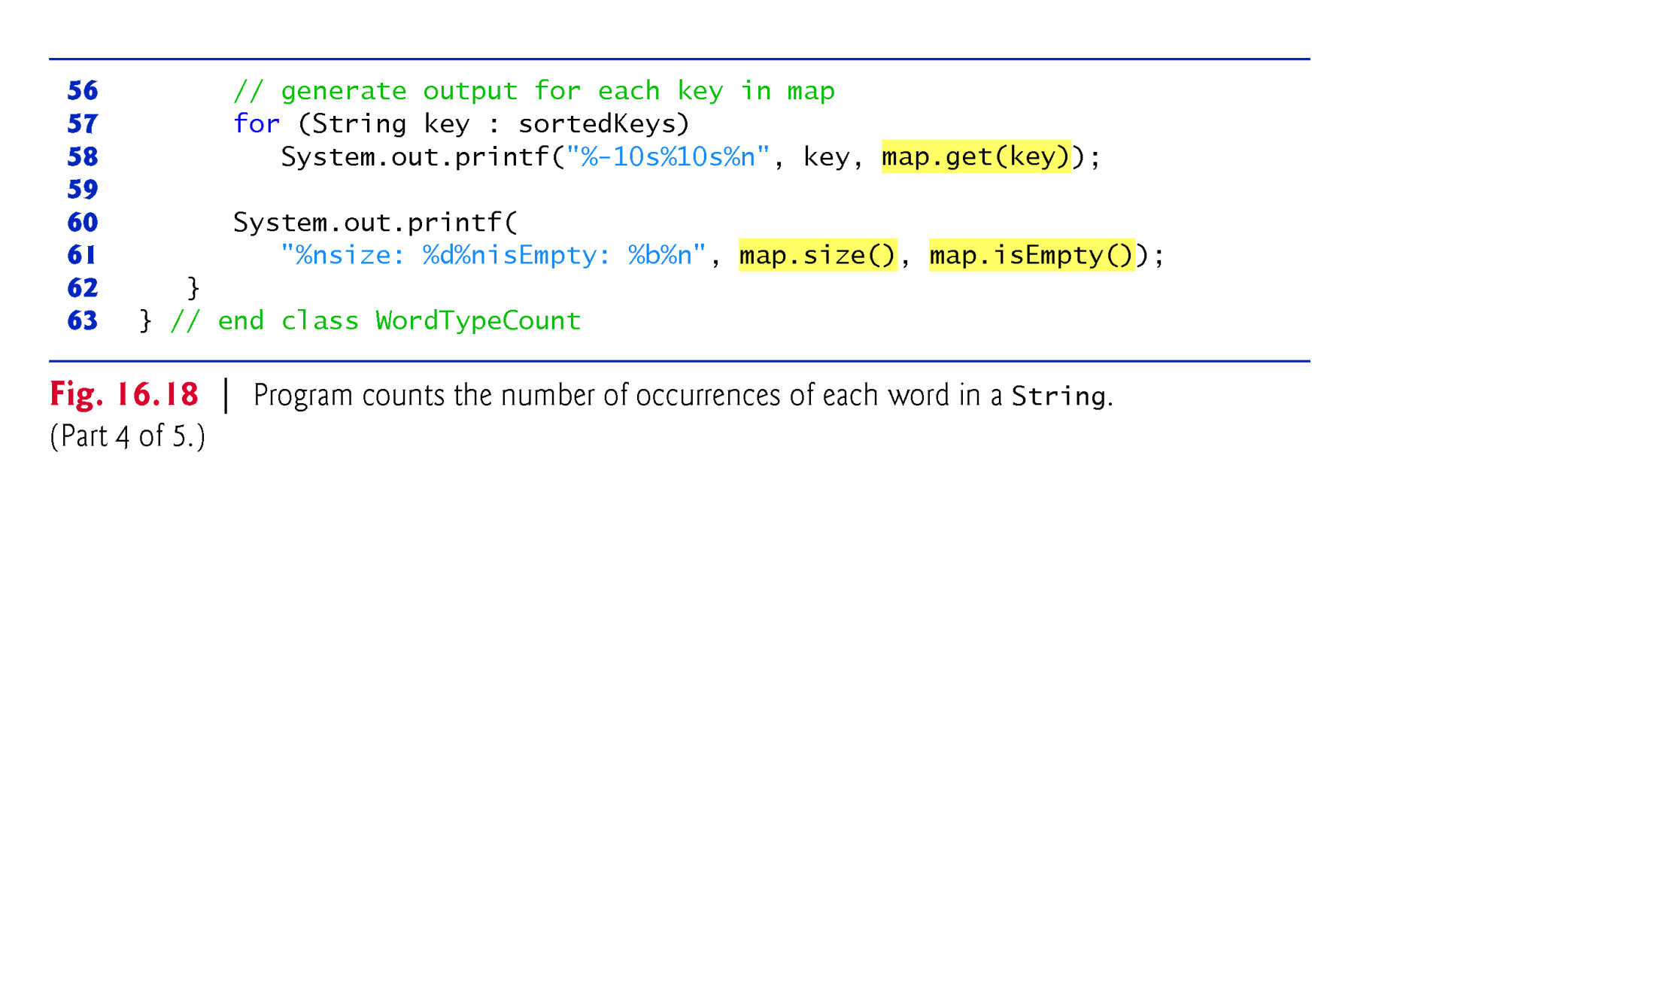
Example 11 . Demo HashMap class

Slide 37
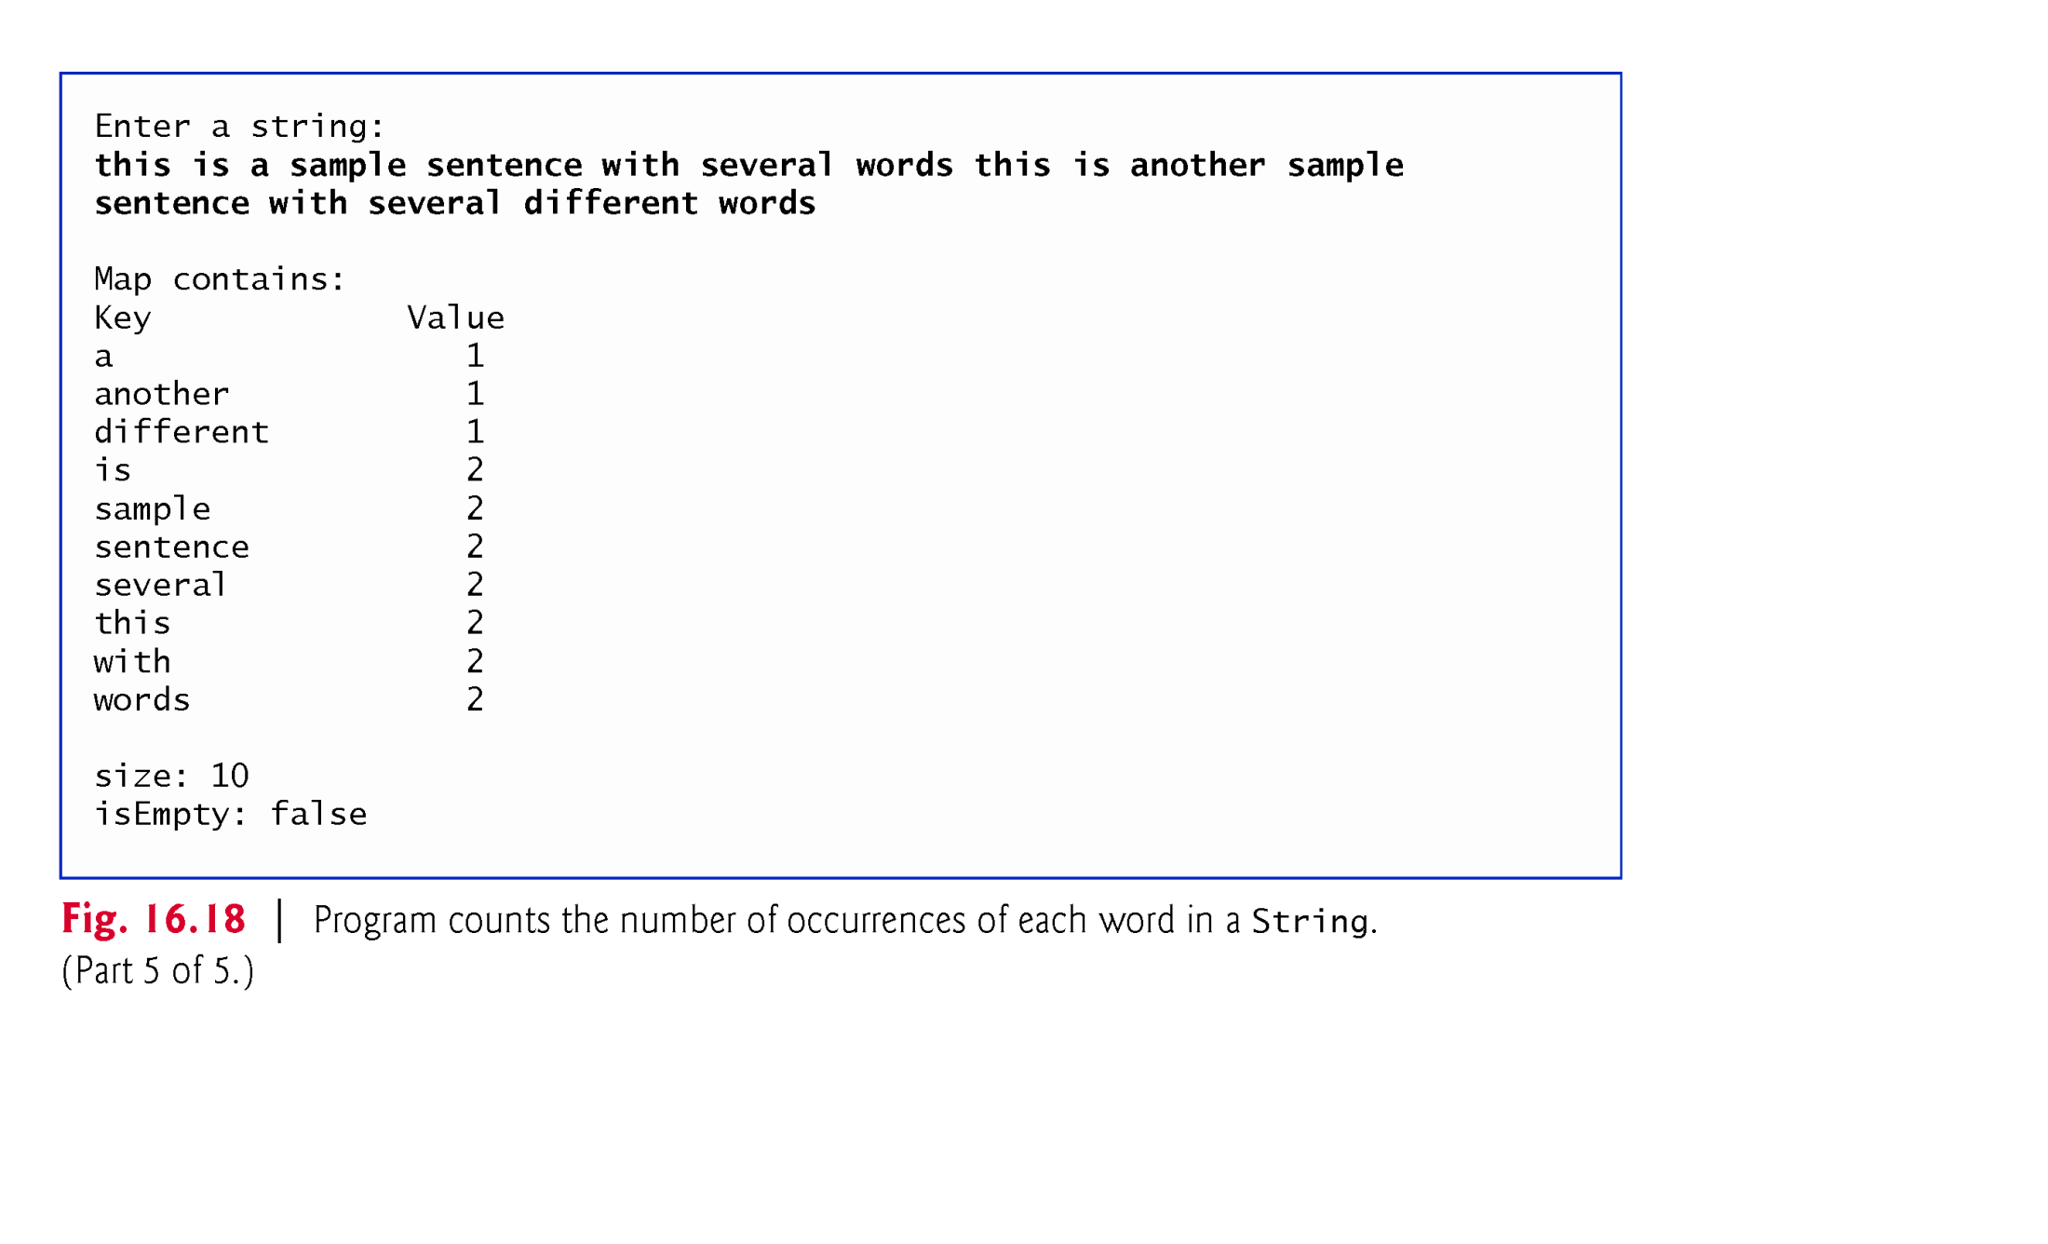
Example 11 . Demo HashMap class

Slide 38
Synchronized and Unmodifiable Collections
Example, the following code creates a synchronized list that stores string objects.
List<String> list1 = new ArrayList<String>();
List<String> list2 = Collections.synchronizedList(list1);
Example, the following code creates unmodifiable List that
List<String> list1 = new ArrayList<>();
List<String> list2 = Collections.unmodifiableList(list1);

Slide 39
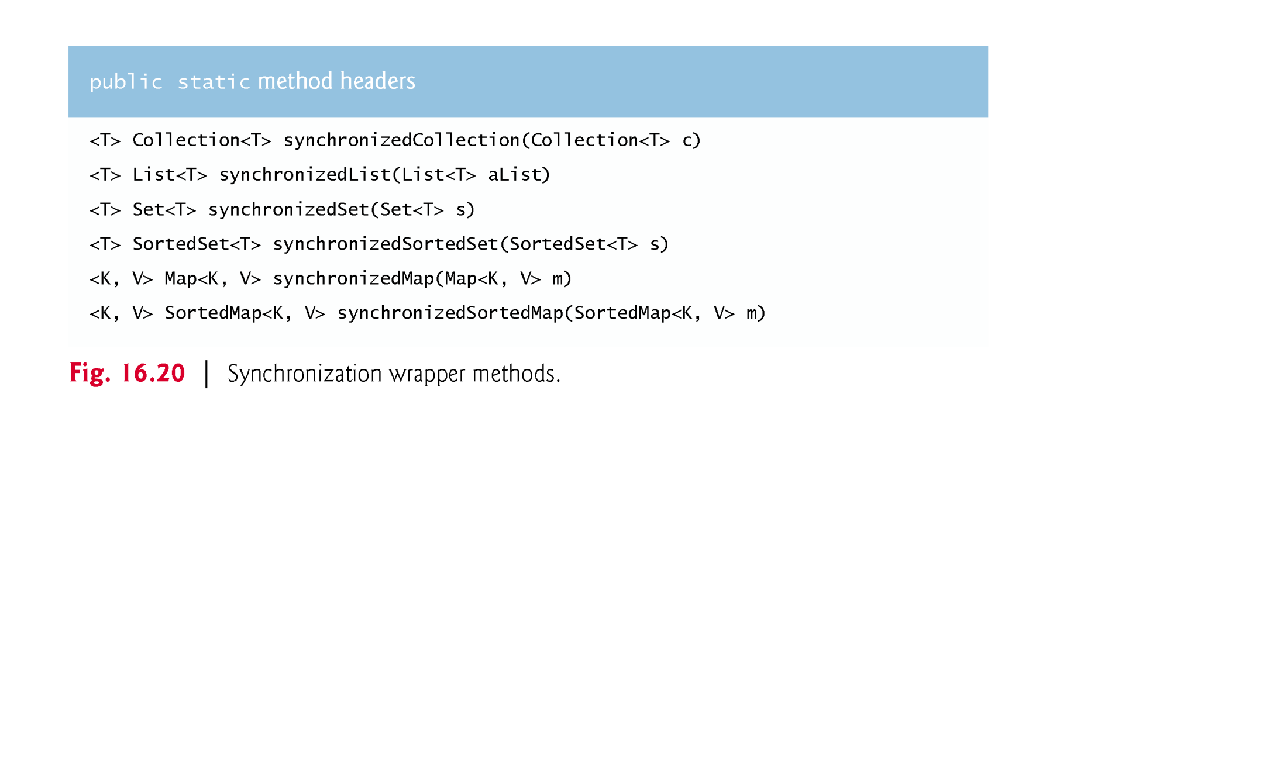
Synchronized Collections cont’d

Slide 40

Unmodifiable Collections cont’d

